Slide 1
About the Course
The long 20th century will in all likelihood be seen in the future as the watershed in human experience:
Nine aspects:
History was primarily economic—and that was true for the first time…
Explosion of wealth: 2%+ per year…
Cornucopia of technology…
Demographic transition…
Feminist revolution…
Empowered tyrannies…
Wealth gulfs…
Inclusion and hierarchy attenuation…
Mismanagement and insecurity…
Humanity is unlikely to see as transformative—for good and ill, but mostly for good, so far at least, I think—a century again…

Slide 2
U.C. Berkeley: Economics 115: Spring 2020
20th Century Economic History: Lecture 7: Understanding the Great Depression
Brad DeLong
Department of Economics and Blum Center, U.C. Berkeley; and WCEG
delong@econ.berkeley.edu
last revised: 2020-02-12
for delivery: W 2020-02-26 17:00 HMMB390
<https://bcourses.berkeley.edu/courses/1487684>
<https://github.com/braddelong/public-files/blob/master/econ-115-lecture-7.pptx>

Slide 3
Preview
Falling in & Coming Out of the Great Depression
Preview
Administration
The Roaring Twenties and “One Big Wave”
The Perfect Storm of 1929-1933
Takeaways

Slide 4
To Your iClickers…
The midterm was:
Fair and easy—but now I am worried about how it will be curved…
Unfair and hard—and now I am really worried about how it will be curved…
Fair and hard—I am thankful I studied the right things…
Fair and hard—but now I am sad I studied the wrong things…
Unfair and easy—and now I am really worried about how it will be curved…

Slide 5
What Were the Takeaways from Last Lecture?
Causes, Nature, & Consequences of the Great Depression

Slide 6
Econ 115: Administration: Office Hours &c.
DeLong: Office Hours
M 11:10-12:40, Blum Hall 200B
T 11:15-12:00, Blum Hall 200B
By appointment in Blum Hall 200B, Evans 691A, or elsewhere: email <delong@econ.berkeley.edu> Sign up at: <https://www.icloud.com/numbers/0leoOOlezWp6BYKSiPJhdXy7Q>
Assignment 6: will be out on Friday Feb 28; due Mar 8...
Memo: bCourses website <https://bcourses.berkeley.edu/courses/1487684>

Slide 7
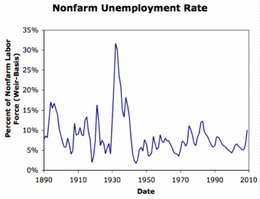
Review: Why the “Perfect Storm” of 1929-1933?
Previous Cycles:
1873—railroad
1884—railroad redux
1893—free silver
1904—Northern Securities
1907—gold drain to Britain
1914—disruption of the start of WWI
1920—deflation; return to “normalcy”
What brought previous downturns to a halt?
What made the Great Depression so great?

Slide 8
To Your iClickers…
How is it possible for market economies to produce a big depression?
When the government—or labor unions—fixes the real wage above the full-employment market-clearing level.
When the government imposes too heavy a tax burden and enterprise, and so businesses are unwilling to invest in adding to their capital stocks.
When there is an excess demand for money, when confidence in banks that can issue money is lacking, and when the government fails to step in and expand the money supply to satisfy the demand.
When it is necessary, due to changing demand, to switch production and employment from one sector to another.
None of the above.

Slide 9
General Glut
How is it that there can be a "general glut" in which pretty much every produced commodity and the labor of workers are in excess supply, given that humans are far from satiated with production goods and given that one person's expenditure is another person's income?
Remember: you can take your income and use it either to buy things that are useful or to build up your stock of cash money. If there is excess demand for useful commodities, people can switch from producing whatever they were making to producing whatever is in short supply.
But the only way to build up your stock of cash is to try to cut your spending below your income. And since one person's spending is another person's income, that simply cannot be done in general.
If people in general try, the result is that spending and incomes fall economywide until they are both at such a low level that people de-prioritize building up their cash holdings.

Slide 10
To Your iClickers…
Why was the interwar gold standard a source of weakness for economic stability?
There was nothing special about the interwar period: the gold standard was always a source of weakness for economic stability,
Because governments had gone off gold in World War I, investors were scared it would do so again and so unwilling to buy bonds; thus central banks had to push interest rates above the level consistent with full employment in order to preserve the gold standard.
Because governments had gone off gold in World War I, households were scared it would do so again and so wished to hoard lots of cash; central banks did not recognize this in time and to the appropriate degree.
There was nothing special about the interwar period: the gold standard was never a source of weakness for economic stability—it was failure to follow the gold standard’s rules that was the source of trouble.
None of the above.

Slide 11
Interwar Gold Standard
The interwar gold standard caused, deepened, and definitely did nothing toward curing or ameliorating the Great Depression…
There is nothing worse than attempting to credibly commit to an incredible policy
The fear that the gold standard would break down caused people to want to hoard cash—to build up their cash holdings.
The fear that the gold standard would break down caused governments to be extremely unwilling to boost their economies' cash supplies—such boosts might, governments feared, undermine confidence that their country would stay on the gold standard.
Big depressions happen when the popular demand for cash outstrips the government's supply
The role of France and the U.S.’s gold-hoarding policy
Fear of inflation: Crying “Fire! Fire!” in Noah’s Flood
The interwar gold standard was thus a powerful motivator and stage-setter pushing both people and governments into the patterns of behavior that produced the Great Depression

Slide 12
The Presumption Before the Great Depression
The presumption before the Great Depression that the government was not responsible for managing and curing the business cycle…
Two strands reinforced each other.
The first was the strength of the idea of laissez-faire: that government (protecting property and enforcing contracts aside) was overwhelmingly a problem and not a solution. As John Maynard Keynes wrote in his essay The End of Laissez-Faire, a powerful drive behind that was: “the corruption and incompetence of eighteenth-century government…. Almost everything which the State did in the eighteenth century in excess of its minimum functions was, or seemed, injurious or unsuccessful. [And] on the other hand, material progress between 1750 and 1850 came from individual initiative…”
The second was social Darwinism—that, in the words of steelmaster Andrew Carnegie, the second-richest man in America circa 1905 and a man who gave away his entire fortune: “The price we pay for [our civilization]... is, no doubt, great.... The employer of thousands is forced into the strictest economies... [in] the rates paid to labor.... The law of competition... is here; we cannot evade it; no substitutes for it have been found; and while the law may be sometimes hard for the individual, it is best for the race, because it insures the survival of the fittest in every department..."
The result was a dominant belief—at least among the rich and powerful—that:
The market giveth, the market taketh away: blessed be the name of the market.

Slide 13
The Hoover Administration’s Reaction to the Great Depression
The 1929-1933 Hoover administration believed that little could be done.
That the only good things that could be done were to (a) repeatedly state that "prosperity is just around the corner" and (b) try to cut federal government spending and raise taxes in order to restore confidence and scotch the fear of high inflation.
As economist R.G. Hawtrey wrote, to worry about inflation in the midst of the Great Depression was like "crying 'FIRE! FIRE!' in Noah's Flood..."
Herbert Hoover himself wrote afterwards about how his administration had been dominated by the "'leave-it-alone liquidationists' headed by Secretary of the Treasury Mellon, [who] felt that government must keep its hands off and let the slump liquidate itself. Mr. Mellon had only one formula:
'Liquidate labor, liquidate stocks, liquidate the farmers, liquidate real estate'. He held that even panic was not altogether a bad thing. He said: 'It will purge the rottenness out of the system. High costs of living and high living will come down. People will work harder, live a more moral life. Values will be adjusted, and enterprising people will pick up the wrecks from less competent people'…"
Hoover went on to state that he did not share this view…
That raises lots of questions about how his administration worked…

Slide 14
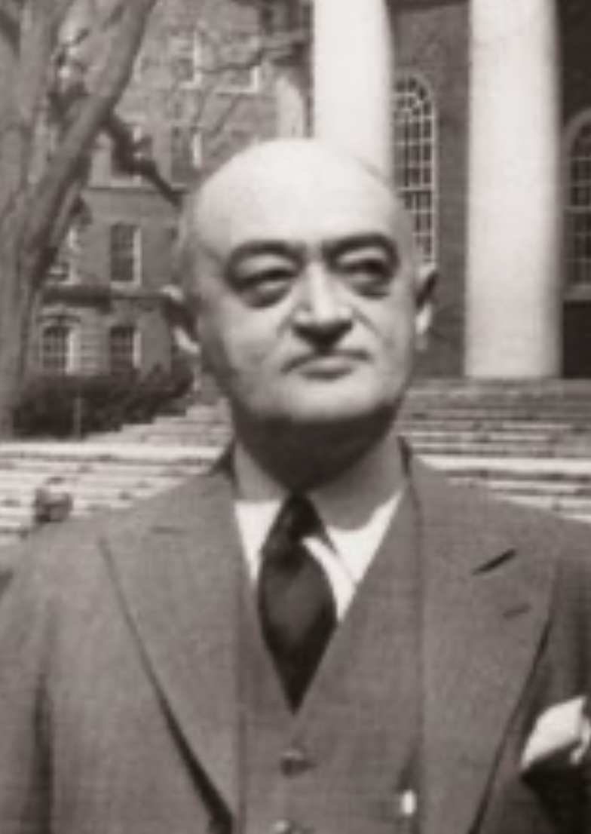
Joseph Schumpeter
Whatever is, & is in the market system, is rational:
“The problems presented by periods of depression may be grouped as follows:
“First, removal of extra economic injuries to the economic mechanism: Mostly impossible on political grounds.
“Second, relief… imperative on moral and social grounds… although no cure for fundamental cases.
“Third, remedies: The chief difficulty of which lies in the fact that depressions are not simply evils, which we might attempt to suppress, but—perhaps undesirable—forms of something which has to be done, namely, adjustment to previous economic change.

Slide 15
Joseph Schumpeter II
Whatever is, & is in the market system, is rational:
“Most of what would be effective in remedying a depression would be equally effective in preventing this adjustment. This is especially true of inflation, which would, if pushed far enough, undoubtedly turn depression in to the sham prosperity so familiar from European postwar [i.e., World War I] experience, but which, if it be carried to that point, would, in the end, lead to a collapse worse than the one it was called in to remedy….
“Fourth, reforms of institutions intended to remedy the situation but suggested by the moral and economic evils of both booms and depressions…. A political atmosphere exceptionally favorable, and an economic situation exceptionally unfavorable to their success… will… be stigmatized in the future by their tendency to prevent or retard recovery…”

Slide 16
Keynes’s Bottom Line
John Maynard Keynes:
“When once the recovery has been started, the manner in which it feeds on itself and cumulates is obvious. But during the downward phase, when both fixed capital and stocks of materials are for the time being redundant and working-capital is being reduced, the schedule of the marginal efficiency of capital may fall so low that it can scarcely be corrected, so as to secure a satisfactory rate of new investment, by any practicable reduction in the rate of interest.
“Thus with markets organised and influenced as they are at present, the market estimation of the marginal efficiency of capital may suffer such enormously wide fluctuations that it cannot be sufficiently offset by corresponding fluctuations in the rate of interest. Moreover, the corresponding movements in the stock-market may, as we have seen above, depress the propensity to consume just when it is most needed. In conditions of laissez-faire the avoidance of wide fluctuations in employment may, therefore, prove impossible without a far-reaching change in the psychology of investment markets such as there is no reason to expect.
“I conclude that the duty of ordering the current volume of investment cannot safely be left in private hands….”

Slide 17
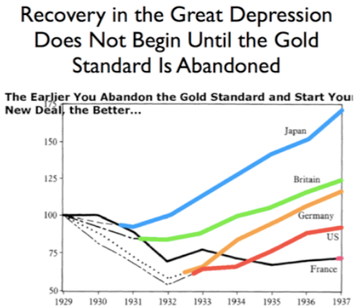
New Deals
Japan: Takahashi Korekiyo
moved early to maintain full employment
Britain: MacDonald-Snowden-Baldwin
Forced off…
Germany: Adolf Hitler
Succeeds Bruening
America: Franklin Delano Roosevelt
Succeeds Herbert Hoover
France: Leon Blum

Slide 18
Recovery
Japan recovered the fastest,
Germany second,
Britain third,
The U.S. fourth,
France last.
By-and-large, the sooner you abandon the gold standard, expand the money supply, and undertake a "New Deal" to boost government spending, the better…

Slide 19
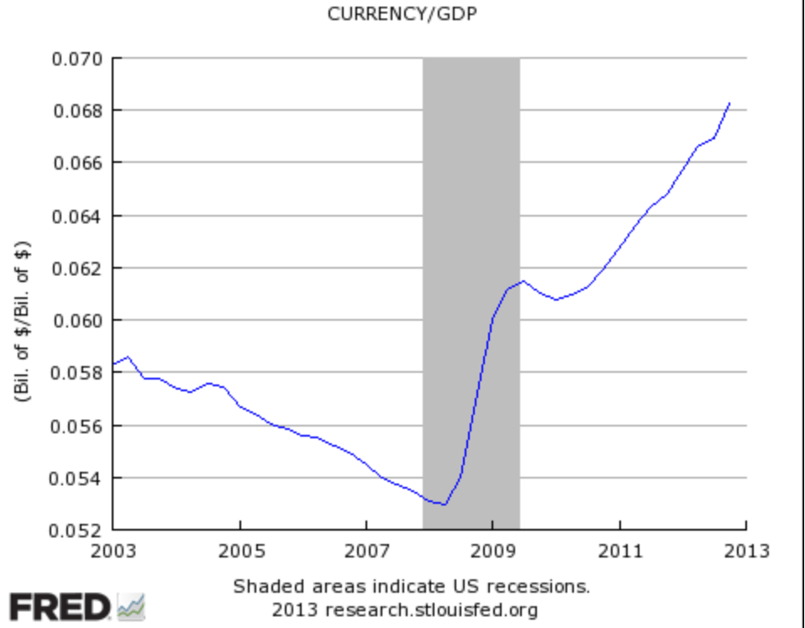
John Maynard Keynes
“It seems unlikely that the influence of banking policy on the rate of interest will be sufficient by itself to determine an optimum rate of investment:
“I conceive, therefore, that a somewhat comprehensive socialisation of investment will prove the only means of securing an approximation to full employment;
“though this need not exclude all manner of compromises and of devices by which public authority will co-operate with private initiative.
“But beyond this no obvious case is made out for a system of State Socialism which would embrace most of the economic life of the community…”

Slide 20
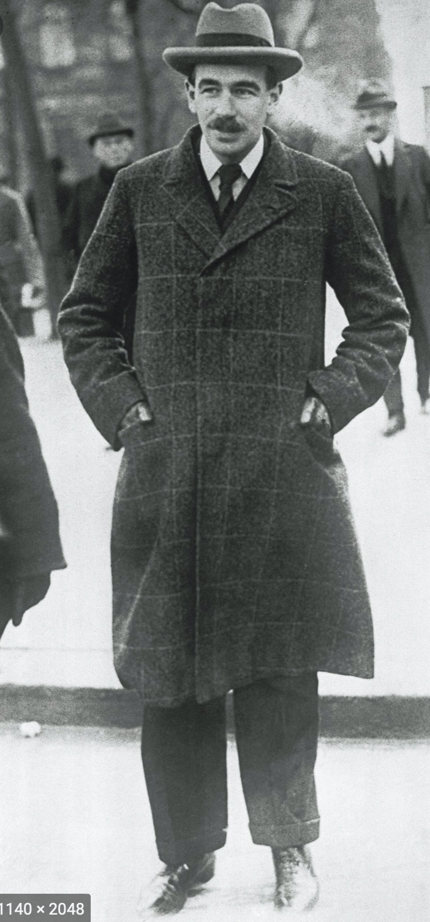
John Maynard Keynes II
“Let us clear from the ground the metaphysical or general principles:
“It is not true that individuals possess a prescriptive 'natural liberty' in their economic activities.
“There is no 'compact' conferring perpetual rights on those who Have or on those who Acquire.
“The world is not so governed from above that private and social interest always coincide.
"It is not so managed here below that in practice they coincide.
“It is not a correct deduction from the principles of economics that enlightened self-interest always operates in the public interest.
“Nor is it true that self-interest generally is enlightened….
“Experience does not show that individuals, when they make up a social unit, are always less clear-sighted than when they act separately….
“I believe that in many cases the ideal size for the unit of control and organisation lies somewhere between the individual and the modern State…”

Slide 21
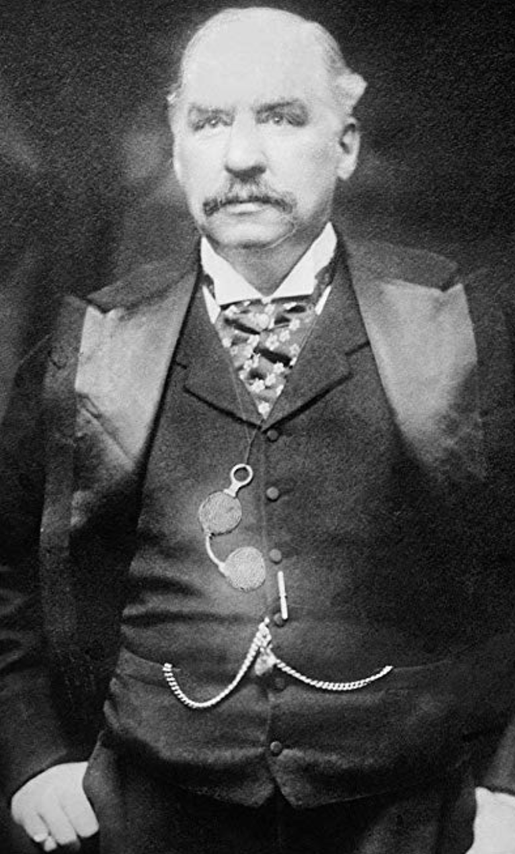
“Moderately Conservative”
John Maynard Keynes:
“Whilst, therefore, the enlargement of the functions of government, involved in the task of adjusting to one another the propensity to consume and the inducement to invest, would seem to a nineteenth-century publicist or to a contemporary American financier to be a terrific encroachment on individualism.
“I defend it, on the contrary, both as the only practicable means of avoiding the destruction of existing economic forms in their entirety and as the condition of the successful functioning of individual initiative.
“For if effective demand is deficient, not only is the public scandal of wasted resources intolerable, but the individual enterpriser who seeks to bring these resources into action is operating with the odds loaded against him…”

Slide 22
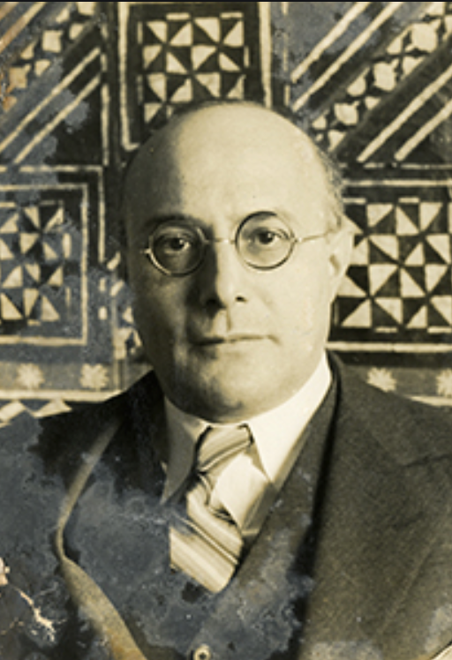
“Fictitious Commodities”: Labor
Karl Polanyi:
“In regard to labor, land, and money… to allow the market mechanism to be sole director of these and their natural environment… would result in the demoli­tion of society.
“For the alleged commodity “labor power” cannot be shoved about, used indiscriminately, or even left unused, without affecting also the human individual who happens to be the bearer of this peculiar commodity.
“In disposing of a man’s labor power the system… would… dispose of the… ‘man’ attached to that tag.
“Robbed of the protective covering of cultural institutions, human beings would perish from the effects of social exposure;
“they would die as the victims of acute social dislocation through vice, perversion, crime, and starvation…”

Slide 23
“Fictitious Commodities”: Land and Finance
Karl Polanyi:
“Nature would be reduced to its elements, neighborhoods and landscapes de­filed, rivers polluted, military safety jeopardized, the power to pro­duce food and raw materials destroyed.
“Finally, the market adminis­tration of purchasing power would periodically liquidate business enterprise, for shortages and surfeits of money would prove as disas­trous to business as floods and droughts in primitive society…”

Slide 24
“Double Movement”
Karl Polanyi:
“The double movement… the action of two organizing principles in society….
“Economic liberalism, aiming at the establishment of a self-regulating market…
“using… laissez-faire and free trade….
“Social protection aiming at the conservation of man and nature as well as productive organization,
“relying on… those most immediately affected by the deleterious action of the market… the working and the landed classes—and
“using protective legislation, restrictive associations, and other instruments of intervention as its methods…”

Slide 25
Class Interest and Public Interest
Karl Polanyi:
“Class is important.…
“The middle classes were the bearers of the nascent market economy… had no organ to sense the dangers involved in the
“exploitation of the physical strength of the worker,
“the destruction of family life,
“the devastation of neighborhoods,
“the denudation of forests,
“the pollution of rivers,
“the deterioration of craft standards,
“the disruption of folkways, and
“the general degradation of existence including housing and arts, as well as
“the innumerable forms of private and public life that do not affect profits….
"To the landed aristocracy and the peasantry fell the task of safeguarding the martial qualities of the nation which continued to depend largely on men and soil, while
the laboring people to a smaller or greater extent, became representatives of the common human interests that had become homeless.
“But at one time or another, each social class stood, even if unconsciously, for interests wider than its own…”

Slide 26
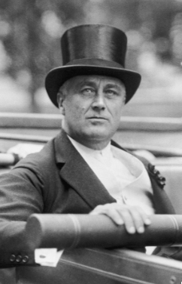
Franklin Delano Roosevelt and His New Deal
What was the alternative going to be?
Roosevelt had no idea
Try everything, and reinforce success:
Abandon the gold standard
Stop austerity
Buy farm products
NIRA—“corporatism”
Financial reform: “the money changers have been cast down from their high seats in the temple of our civilization…”
WPA
CCC
Social Security
NLRB
PUHCA

Slide 27
Social Insurance
The Beveridge Report
Post-WWII British Labour Socialism
The U.S. New Deal
Social Security
AFDC
NLRA
TVA
SEC
Military Keynesianism

Slide 28
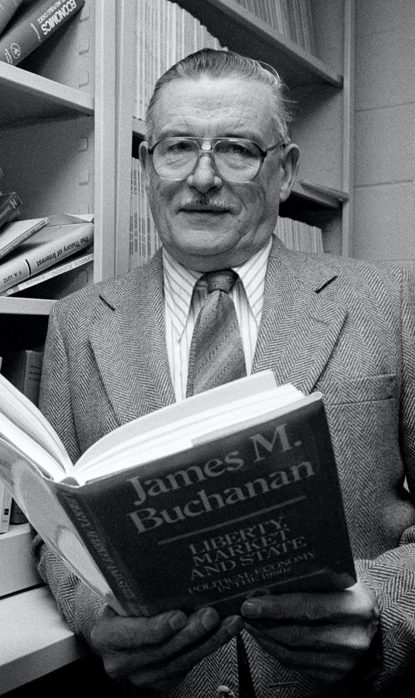
Counteroffensive from Mt. Pelerin
James Buchanan:
“The Keynesian episode in economics is… orthogonal to any attribution of progression or retrogression in the hard core of the research program of the discipline.
“The Keynesian enterprise can be interpreted as an ultimately failed attempt to jury-rig improvements on a structure of institutional constraints that were nonsustainable….
“The whole exercise [w]as an aberration that was grounded in rather elementary misunderstanding of what the classical vision of political economy embodies….
“It seems naive to think that ‘the market’… can operate effectively… adjust quickly to a dramatic reduction in the politically-influenced and unpredictable supply of money?
“It must remain forever mysterious as to why Keynes and the Keynesians were willing to neglect prospects for institutional reforms in the effective monetary constitution, while, at the same time, proposing radical changes along other more specific dimensions of policy....
“The Keynesian tragedy is locatcd in the timidity of its nostrums in the face of existing institutions, accompanied by its willingness to replace market evaluations by politicized controls over particular choice vectors (employment, investment)…”

Slide 29
To Your iClickers…
Which three politicians reacted best to the challenges of the Great Depression?
Takehishi Korekiyu, Adolf Hitler, and Franklin Roosevelt
Theodore Roosevelt, Woodrow Wilson, and Franklin Roosevelt
Herbert Hoover, Calvin Coolidge, and Neville Chamberlain
Herbert Hoover, Franklin Roosevelt, and Leon Blum
None of the above sets reacted well.

Slide 30
Alternatives to Let-It-Alone Market Society
Laissez-Faire Capitalism Failed in the Depression:
The Old Order bankrupted itself with its insistence on austerity and on the gold standard—“tough it out” as the way to get to the other side of the Great Depression
Socialist parties had grown with urbanization, industrialization, visible high inequality, and prosperity.
Socialists, following Marx, confidently predicted that capitalist breakdown would empower left-wing revolution
But by and large the swing was to the right, rather than to the left
Except in the United States

Slide 31
What Was the Alternative Going to Be?
Socialists thought that the alternative should be some form of communism:
Collective ownership of the means of production
Conscious management of the economy to avoid “irrationalities”
Nationalists thought that the problem was that the global international economy was run for the benefit of rich foreigners
Especially Jews
Proletarian nations that were unfairly deprived of resources and markets, rather than proletarian classes…

Slide 32
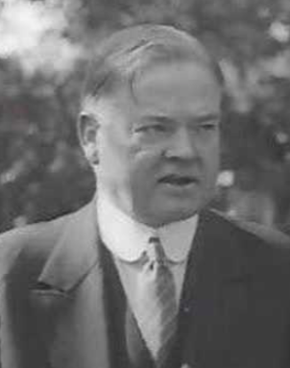
Herbert Hoover and Austerity
1932: This message is “devoted solely to the necessity for balancing the budget…. Nothing is more necessary…. Nothing will put more heart into the country than prompt and courageous and united action…. The details and requirements… are now well known… plainly require: 1. The prompt enactment of a revenue bill…. 2. A drastic program of economy…”

Slide 33
Franklin Delano Roosevelt and His New Deal
What was the alternative going to be?
Roosevelt had no idea
Try everything, and reinforce success:
Abandon the gold standard
Stop austerity
Buy farm products
NIRA—“corporatism”
Financial reform: “the money changers have been cast down from their high seats in the temple of our civilization…”
WPA
CCC
Social Security
NLRB
PUHCA

Slide 34
Franklin Delano Roosevelt and His New Deal II
Keynes: “I think there is a great deal to be said for the ownership of all the utilities by publicly owned boards. But if public opinion is not yet ripe for this, what is the object of chasing the utilities around the lot every other week?… A convincing policy, whatever its details may be, for promoting large-scale investment under the above heads is an urgent necessity. These things take time. Far too much precious time has passed. I must not encumber this letter with technical suggestions for reviving the capital market. This is important. But not so important as the revival of sources of demand. If demand and confidence reappear, the problems of the capital market will not seem so difficult…. Forgive the candour…. They come from an enthusiastic well-wisher…. I am terrified lest progressive causes… suffer injur, because you have taken too lightly the risk… from a failure measured in terms of immediate prosperity. There need be no failure. But the maintenance of prosperity in the modern world is extremely difficult; and it is so easy to lose precious time…”

Slide 35
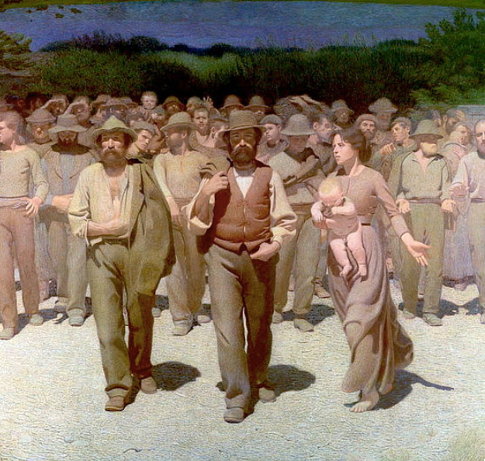
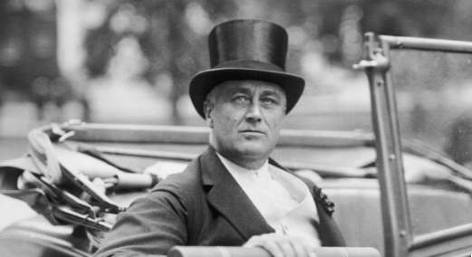
Really-Existing Socialism
An ultimately unsuccessful challenger:
Ernest Gellner:
“Just as extreme Shi’ite Muslims hold that Archangel Gabriel made a mistake, delivering the Message to Muhammed when it was intended for Ali…
“so Marxists… think… [the] message was intended for classes, but was delivered to nations.
“It is now necessary for revolutionary activists to persuade the wrongful recipient to hand over the message and the zeal…”

Slide 36
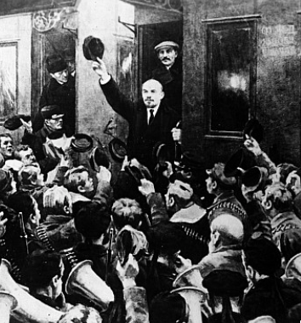
The Soviet Trajectory
Imperatives
Survive
Eliminate large-scale private property and market
Industrialize
No aid coming from Germany
War Communism
War Terror
NEP
“Scissors Crisis”
Capital as a business model
Nationalities question

Slide 37
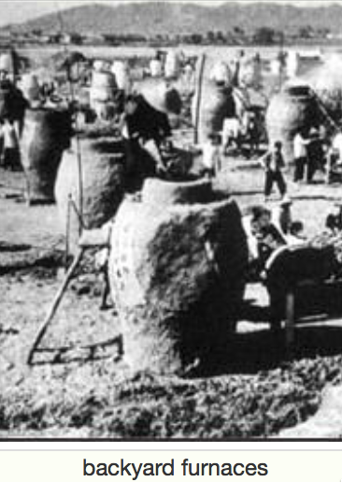
Failed Utopia: The Butcher’s Bill
Russian Civil War: 3M?
Collectivization of agriculture: 10M?
Great Terror: 2M?
Post-WWII purge: 2M?
Anti-landlordism: 4M?
Collectivization: 4M?
Great Leap Forward famine: 50M?
Cultural Revolution: 5M?
Pol Pot: 1.5M
Kim Dynasty: ????

Slide 38
The Soviet Union: Late Development
If the Soviet Union was “European” or “recent settlement”—an absolute disaster.
If you compare the Soviet Block to the countries around its edge—an absolute disaster
Why? Because bureaucracies undisciplined by markets are really not very good at organizing production
They can—sometimes—duplicate things they can see elsewhere
They can—sometimes—generate amazing feats of resource mobilization
While sharply reducing “profiteering”
When do we want “hard incentives”, anyway?

Slide 39
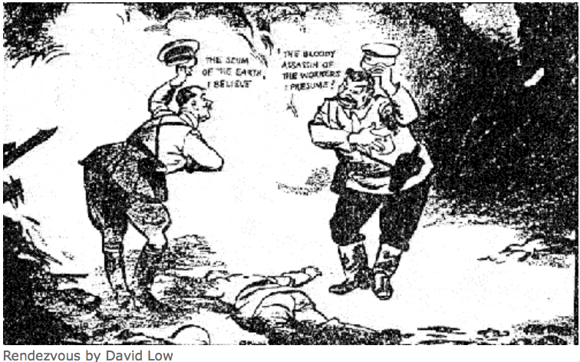
The Soviet Union: Tyranny
Should we dismiss the Soviet Union as simply a tyranny?
One in which the standard ways of bullying and oppressing people are reinforced by technologies of bureaucracy and indoctrination?
“Fake News” goes back to the Norman Conquest, after all…
We are just better at it…

Slide 40
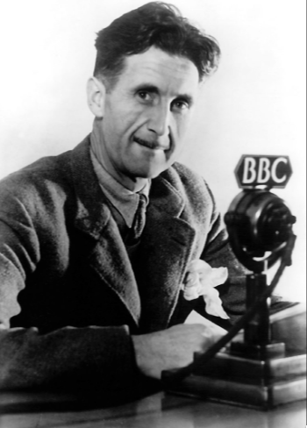
The George Orwell Tradition
George Orwell’s 1984
Estate-based authoritarianism as the natural Agrarian Age form of government
Totalitarianism as the natural Industrial Age form of government: “a boot stamping on a human face, forever…”
What is “totalitarianism”?
Is it possible?
Is it stable?
Is it a model?
Religious or quasi-religious fervor?
Cf.: Hobsbawm

Slide 41
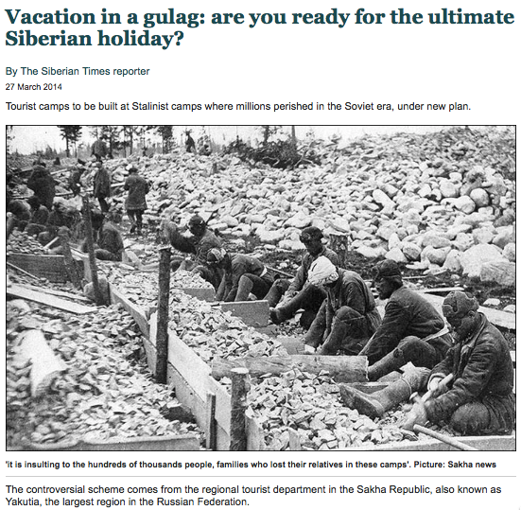
Failed Utopia: Social and Economic Organization
Max Weber: “Wherever bureaucracy gained the upper hand… it did not disappear…. State bureaucracy would rule alone if private capitalism were eliminated. The private and public bureaucracies, which now check one another to a degree, would be merged into a single hierarchy.
“This would be similar to the situation in ancient Egypt, but it would occur in a much more rational—and hence unbreakable—form… the shell of bondage which men will perhaps be forced to inhabit as powerless as the fellahs of ancient Egypt. Who would want to deny that such a potentiality lies in the womb of the future?…”

Slide 42
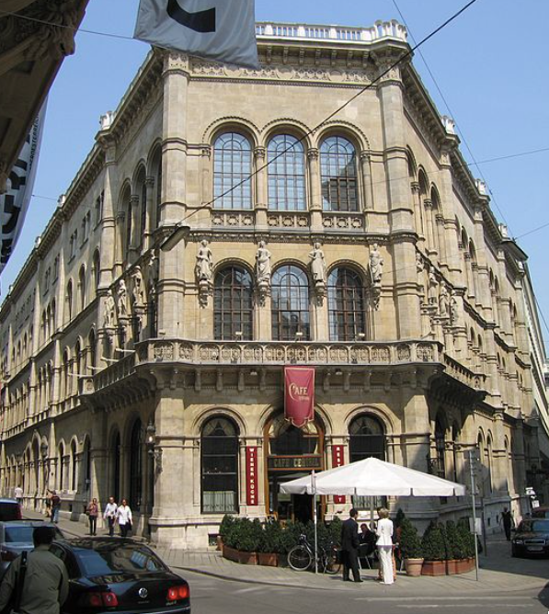
Failed Utopia: The Costs of the “Experiment”
Guenther Roth: “Weber and Schumpeter... had their famous falling-out in a Viennese coffeehouse in 1918. Weber, ‘who took nothing lightly,’ and Schumpeter, who ‘took nothing hard,’ recalled Somary who witnessed the scene, clashed over the Russian Revolution.
“Schumpeter welcomed it as a laboratory experiment…. For Weber it was going to be ‘a laboratory heaped with human corpses.’ When an enraged Weber stormed out, a smiling Schumpeter remarked: ‘How can someone carry on like that in a coffeehouse?’—the proper place for irony, never seriousness…”

Slide 43
The Butcher’s Bill: The Inner Party
Russian Civil War: 3M?
Collectivization of agriculture: 10M?
Great Terror: 2M?
Post-WWII purge: 2M?
Anti-landlordism: 4M?
Collectivization: 4M?
Great Leap Forward famine: 50M?
Cultural Revolution: 5M?
Pol Pot: 1.5M
Kim Dynasty: ????

Slide 44
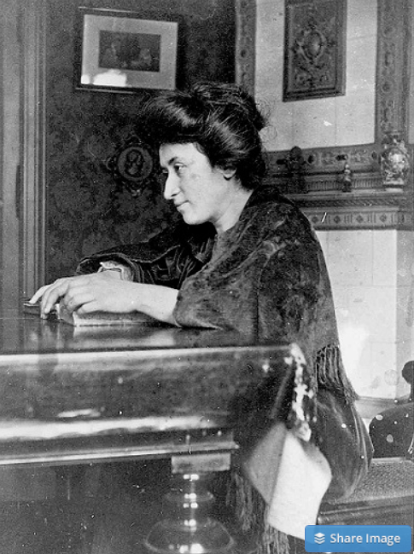
Failed Utopia: Politics
Rosa Luxemburg: “The tacit assumption underlying the Lenin-Trotsky theory of dictatorship is this: that the socialist transformation is something for which a ready-made formula lies completed in the pocket of the revolutionary party…. We [do] know more or less what we must eliminate…
“But when it comes to the nature of the thousand concrete, practical measures, large and small, necessary to introduce socialist principles into economy, law and all social relationships, there is no key in any socialist party program or textbook. That is not a shortcoming but rather the very thing that makes scientific socialism superior to the utopian varieties…”
What did Lenin do? The German war economy…

Slide 45
Failed Utopia: Politics II
Rosa Luxemburg: “In place of… general, popular elections, Lenin and Trotsky have laid down the soviets…. Public life gradually falls asleep, a few dozen party leaders of inexhaustible energy and boundless experience direct and rule… meetings… [that] approve proposed resolutions unanimously… the dictatorship of a handful of politicians…. Such conditions must inevitably cause a brutalization of public life: attempted assassinations, shooting of hostages, etc…”

Slide 46
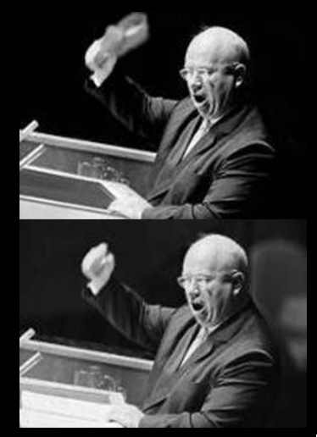
Failed Utopia: Our Friend Nikita Sergeyevitch
Francis Spufford: “So much blood, and only one justification for it…. If it had been all prologue, all only the last spasms of death in the old, cruel world…. Today the radio was reporting… Prague….
“He fumbled with the tape machine… found the RECORD key…. ‘Paradise’, he told the wheat field in baffled fury: ‘is a place where people want to end up, not a place they run from. What kind of socialism is that? What kind of shit is that, when you have to keep people in chains. What kind of social order? What kind of paradise?…’
“And then… the retired monster sat very still on the bench by the field…”

Slide 47
And Yet There Was Optimism in the 1930s…
The “economic problem” not the permanent problem of the human race
John Maynard Keynes thought that the economic problem would not be the "major problem of the human race"
By the end of the twentieth century the human race would be so rich that people would be practically satiated with commodities.
Thus the "economic problem" of how to economize and be efficient, and allocate scarce means among alternative uses, was not the permanent problem of the human race.
Instead, "for the first time since his creation man will be faced with his real, his permanent problem-how to use his freedom from pressing economic cares, how to occupy the leisure, which science and compound interest will have won for him, to live wisely and agreeably and well.... It will be those peoples, who can keep alive, and cultivate into a fuller perfection, the art of life itself and do not sell themselves for the means of life, who will be able to enjoy the abundance when it comes..."
Yet Keynes was not sure that having to confront this problem would be a net plus for humanity: "Will this be a benefit? If one believes at all in the real values of life, the prospect at least opens up the possibility of benefit. Yet I think with dread of the readjustment of the habits and instincts of the ordinary man, bred into him for countless generations, which he may be asked to discard within a few decades..."

Slide 48
Takeaways
Understanding the Great Depression

Slide 49
Preview: Next Time
After the midterm, we will go into “really existing socialism”…
Lenin
Trotsky
Stalin
Khrushchev
Brezhnev
Andropov
Chernenko
Gorbachev

Slide 50
What Was Unconvincing Today?
Mistakes and unclarities: typos, wordos, and mindos…
In the DRAFT textbook?
In the lecture?

Slide 51
Catch Our Breath…
Ask a couple of questions?
Make a couple of comments?
Any more readings to recommend?

Slide 52
Notes

Slide 53
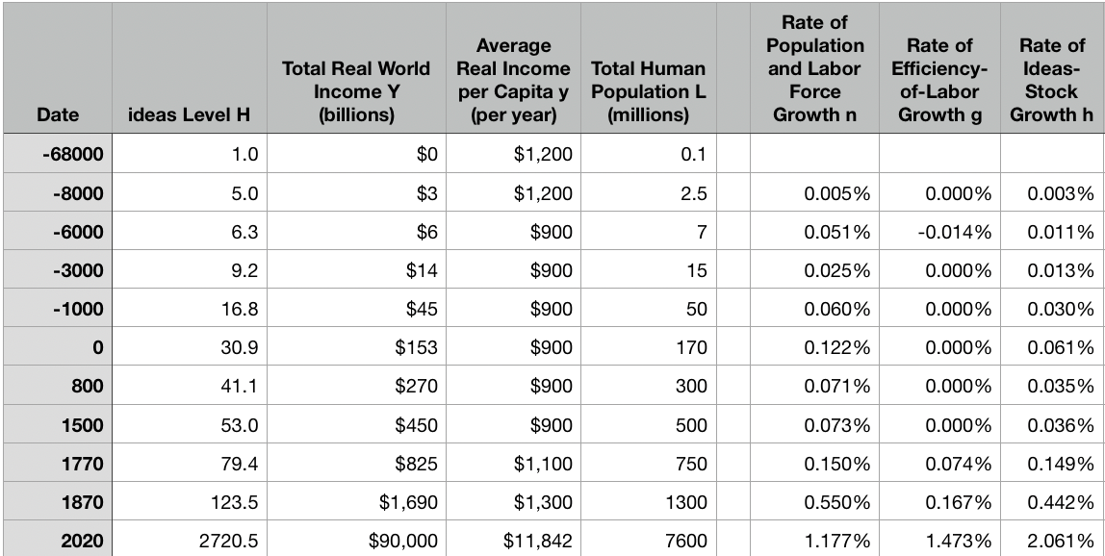
Review: The Broad Sweep
Post-1870 is the miracle:

Slide 54
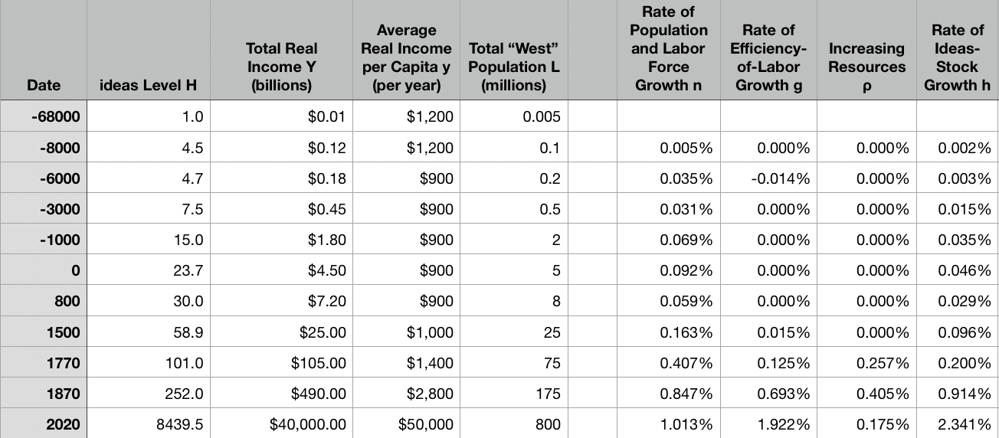
“The West”
800, 1500, 1770, or 1870?:

Slide 55
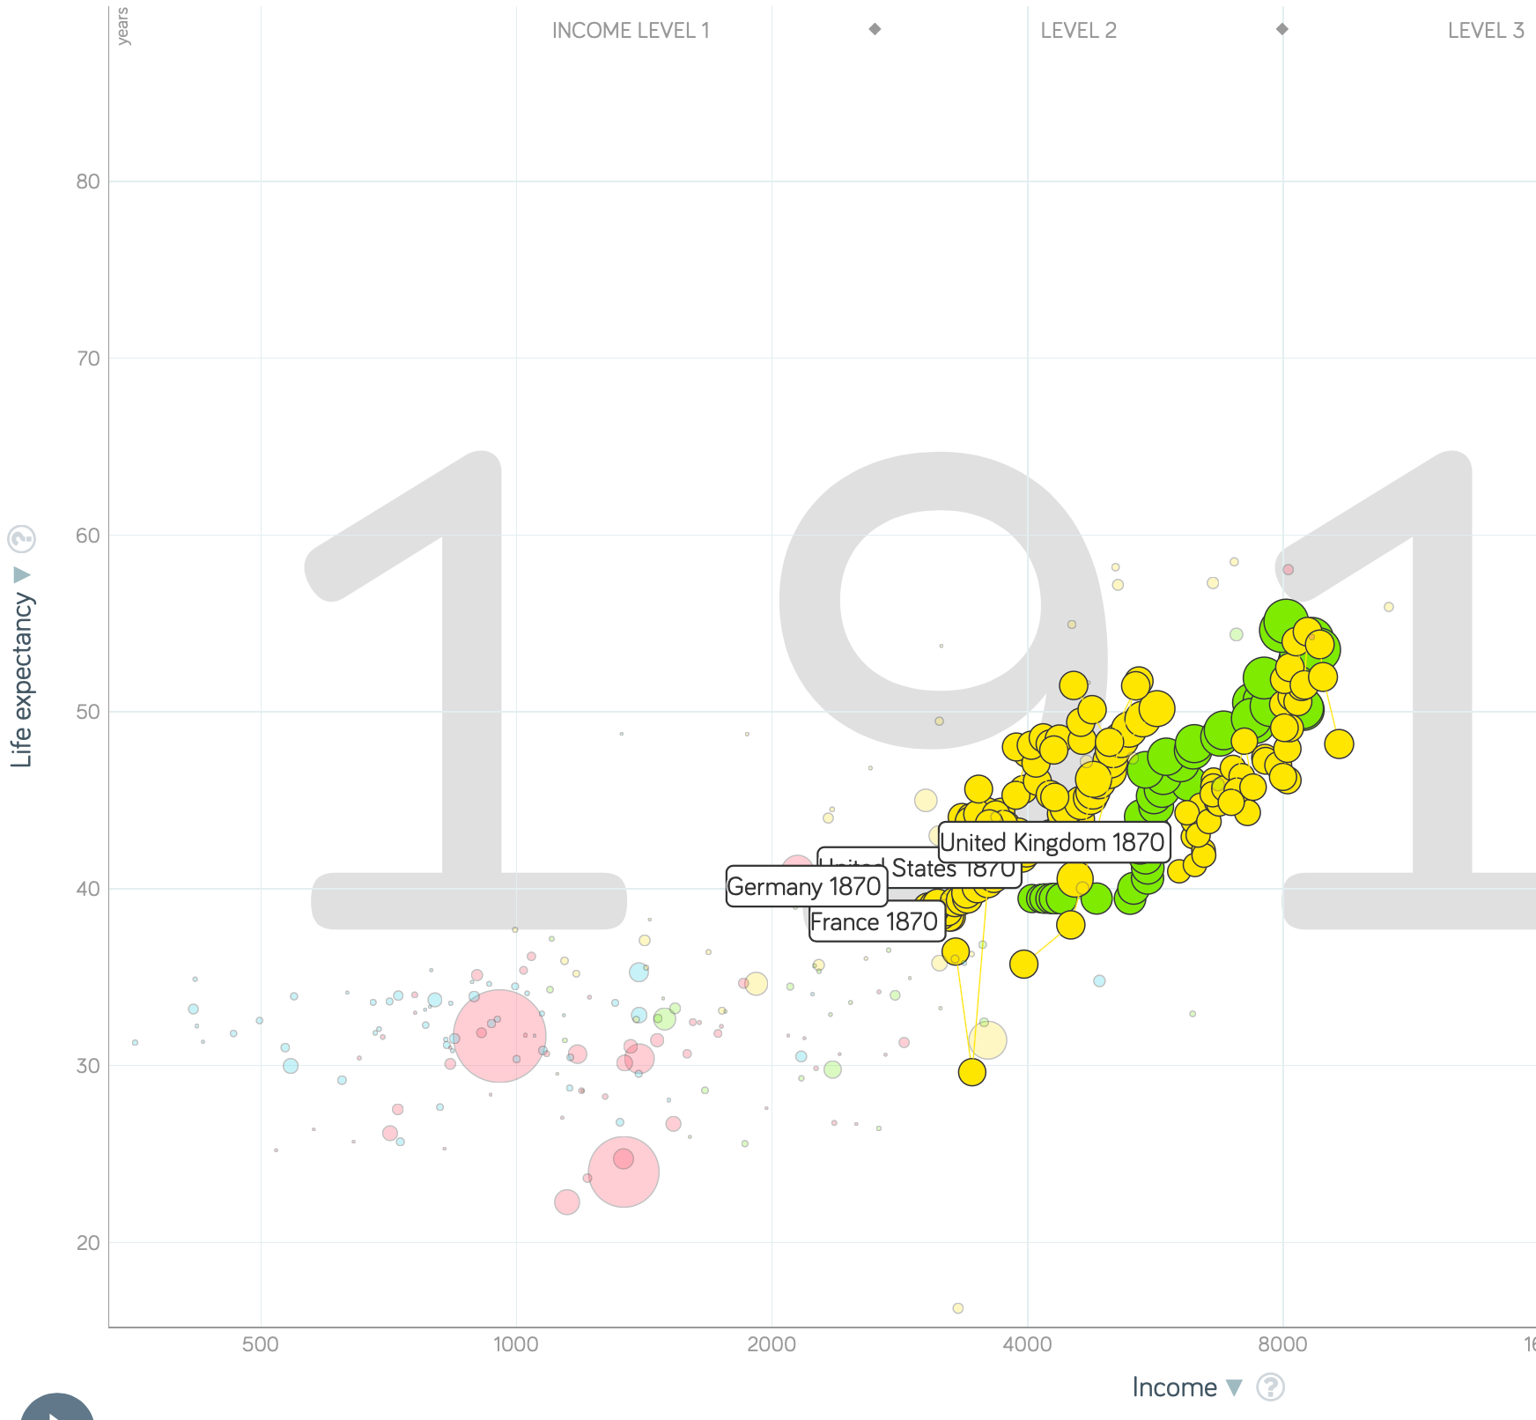
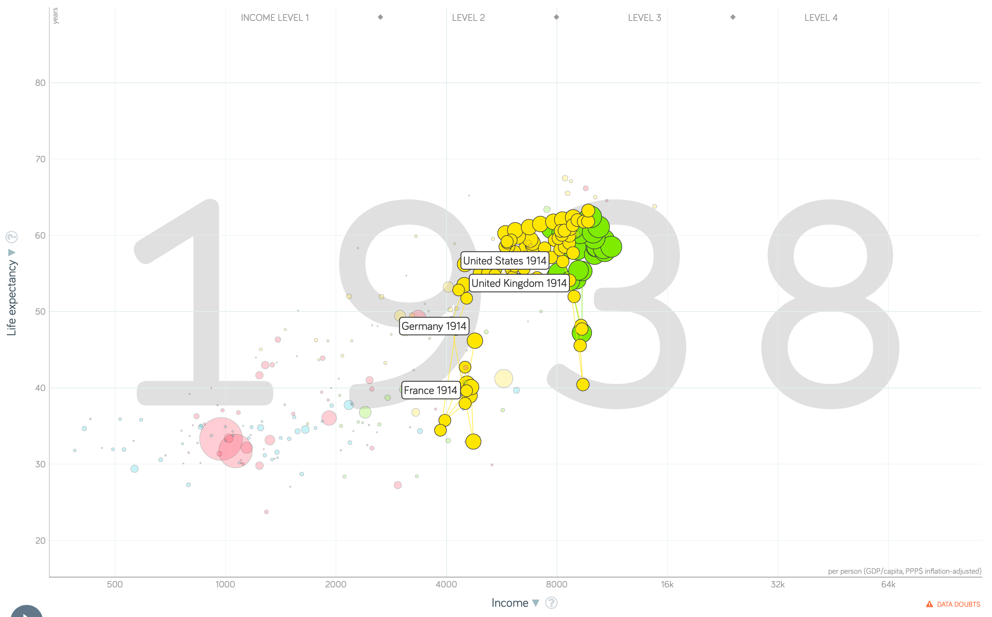
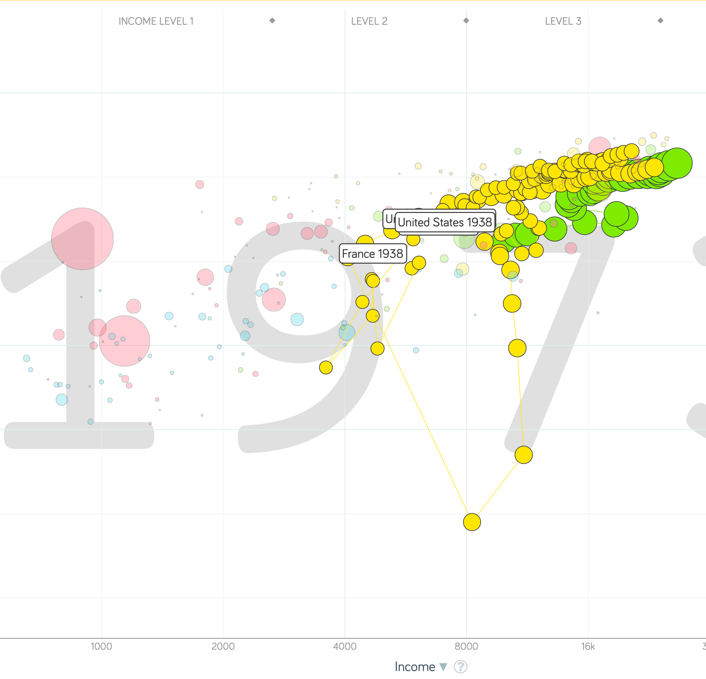
“The West”
1914-1938, 1870-1913, & 1938-1973
Rate of growth in the North Atlantic industrial core halves comparing 1870-1913 to 1914-1938; then triples afterwards over 1938-1973
Slows again after 1973

Slide 56
To Your iClickers
What was the growth rate of ideas in the industrial core of the world economy over 1870-2020?
About 2.3%/year
About 0.9%/year
About 0.23%/year
About 4%/year
None of the above

Slide 57
To Your iClickers
What was the growth rate of ideas in the industrial core of the world economy over 1770-1870?
About 2.3%/year
About 0.9%/year
About 0.23%/year
About 4%/year
None of the above

Slide 58
Review: The Belle Époque Broken
John Maynard Keynes:
“Very few of us realise[d] with conviction the intensely unusual, unstable, complicated, unreliable, temporary nature of the economic organisation by which Western Europe has lived for the last half century. We assume some of the most peculiar and temporary of our late advantages as natural, permanent, and to be depended on, and we lay our plans accordingly.
“On this sandy and false foundation we scheme for social improvement and dress our political platforms, pursue our animosities and particular ambitions, and feel ourselves with enough margin in hand to foster, not assuage, civil conflict in the European family....
“France, Germany, Italy, Austria, and Holland, Russia and Roumania and Poland, throb together, and their structure and civilisation are essentially one. They flourished together, they have rocked together in a war which we, in spite of our enormous contributions and sacrifices (like though in a less degree than America), economically stood outside, and they may fall together…”

Slide 59
Aristocracy & Social Democracy
The aristocrats had rolled the dice:
Europe in 1914 was a Europe of national populations, of industrialists and socialists, of factory workers and technicians…
Europe’s governments in 1914—especially the defense and foreign affairs ministries—had been populated by aristocrats, ex-aristocrats, and would-be aristocrats.
Landed, aristocratic, military elites had control of many of the levers of propaganda and power…
Aristocrats had had help. Industrialists and entrepreneurs were eager to provide their political support in return for economic benefits, as in the 1879 German “marriage of iron and rye”: the imposition of tariffs on imports of British steel (to protect the positions of German manufacturers) and on imports of American grain (to protect the positions of German landlords)…
On the eve of World War I, these landed military service aristocrats, ex-aristocrats, and would-be aristocrats increasingly found themselves members of a social caste that had no societal function…
But power—in the form of office and of vast (if declining relative) wealth—and propaganda—in the form of pageantry and the press—were reinforced by ideologies: Social darwinism…
The aristocrats rolled the dice—and lost…
Social democrats picked up the chips:
Expanded suffrage…
Proportional representation…
“Lands fit for heroes…”
How to provide for the benefits politicians promised?

Slide 60
Reparations, Taxes, and Inflation
Reparations
A peace “without annexations and indemnities”…
But not without reparations…
Two years’ of Germany’s national income demanded:
Much of it “boob bait for the bubbas…” on the part of Allied politicians…
But a powerful shaper of post-WWI Germany
Taxes
High and progressive tax rates…
A powerful impact on inequality…
Class war…
Inflation
U.S.: price level x1.5
Britain: price level x2.0
France: price level x7.0
French government had encouraged investment in Russian bonds…
German: price level x1,000,000,000,000
Austria, Hungary, Czechoslovakia the same…

Slide 61
Keynes’s Protest
Jan Christian Smuts:
“Poor Keynes often sits with me at night after a good dinner and we rail against the world and the coming flood. And I tell him that this is the time for Grigua’s prayer (the Lord to come himself and not to send his Son, as this is not a time for children). And then we laugh, and behind the laughter is [Herbert] Hoover’s horrible picture of thirty million people who must die unless there is some great intervention. But then again we think that things are never really as bad as that; and something will turn up, and the worst will never be. And somehow all these phases of feeling are true and right in some sense…”

Slide 62
Keynes’s Protest II
John Maynard Keynes:
“If we aim deliberately at the impoverishment of Central Europe, vengeance, I dare predict, will not limp. Nothing can then delay for long that final civil war between the forces of reaction and the despairing convulsions of revolution, before which the horrors of the late German war will fade into nothing, and which will destroy... the civilization and progress of our generation…”

Slide 63
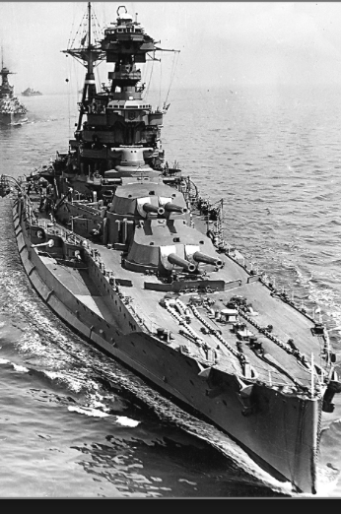
Review: World War I
Nationalism
Max Weber: “The vulgar conception of political economy is that it consists in working out recipes for making the world happy.… However… elbow-room… can [only] be won… through the hard struggle.... That standard of value adopted by a German economic theorist, can… be nothing other than a German policy and a German standard.... Our successors will... hold us responsible... for the amount of elbow-room we conquer.... The science of political economy is... a servant of... the lasting political-power interests of... our nation's power, and the vehicle of that power, the German national state…”
Erich von Manstein: von Manstein, von Lewinsky, Lewinski, Levi…
“We offered 4 battleships a year, the navy demanded 6, and we compromised at 8”

Slide 64
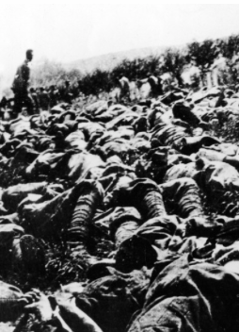
The Catastrophe of World War I: Origins
In the summer of 1914 the empires of Russia and Austria-Hungary are skirmishing diplomatically and threatening each other militarily about the latest Balkan crisis
Began when in the summer of 1914 the Archduke Franz Ferdinand and his wife Sophie were assassinated in Sarajevo
By terrorists with very close links to the intelligence service of the Kingdom of Serbia
What would Austria’s response be?
And then Germany attacks Belgium
And then Australia attacks Turkey

Slide 65
The Catastrophe of World War I: Causes
Why?: “If there is a war, let it come now…”
Russia thought it would have to fight Germany someday, and might as well while France was interested…
Austria, France, Britain (as a result of the German battle fleet) the same
“Busy giddy minds with foreign quarrels…”
A wiser man: Otto von Bismarck:
“There is nothing in the Balkans worth the bones of a single Pomeranian grenadier…”

Slide 66
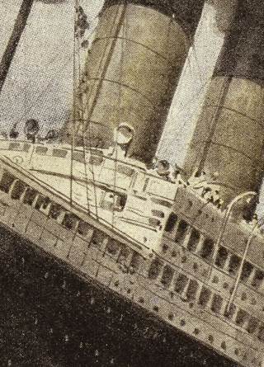
How Does the U.S. Get Involved?
British policy: binding the U.S. upper class to Britain since the 1840s
The Law of the Sea
Neutrals
Blockade
The submarine
Unrestricted submarine warfare
Zimmerman Telegram
Woodrow Wilson
“Teach the Mexicans to elect good men…”
“The war to end war…”

Slide 67
The Catastrophe of World War I: Outcome—Human
Combatants had mobilized 65M out of 100M men of military age
10M killed
10M maimed
Civilian casualties less than 10% of military
Costs of 1.5x a year’s GDP
Plus a 15M global flu epidemic
Russian, Austro-Hungarian, German, Ottoman Turkish Empires all gone…
Representative governments destabilized—or weak…
The Russian Revolution…
Hungarian, Bavarian socialist republics (short-lived)
Spartakist…
Allies demand 2 years of German GDP as “reparations”…

Slide 68
Catch Our Breath…
Comments?
Questions?

Slide 69

Review: Edward Bellamy: Looking Backward
Edward Bellamy: Looking Backward <https://delong.typepad.com/files/bellamy-backward.pdf>: Perhaps the third best-selling novel of the 19th century in the United States
2000 is a utopia…
The narrator is carried forward in time from 1887-2000 by an implausible plot device:
‘“This is the tenth day of September in the year 2000, and you have slept exactly one hundred and thirteen years, three months, and eleven days…”’
He then wanders around, looking at the utopia of 2000…
The opening:
‘“How could I live without service to the world?” you ask…. The answer is that my great-grandfather had accumulated a sum of money on which his descendants had ever since…. The sum had been originally by no means large. It was, in fact, much larger now that three generations had been supported upon it in idleness, than it was at first…’

Slide 70
The Stagecoach of Society
Those who ride and this who pull:
‘Commiseration was frequently expressed by those who rode for those who had to pull the coach, especially when the vehicle came to a bad place in the road, as it was constantly doing, or to a particularly steep hill. At such times, the desperate straining of the team, their agonized leaping and plunging under the pitiless lashing of hunger, the many who fainted at the rope and were trampled in the mire, made a very distressing spectacle, which often called forth highly creditable displays of feeling on the top of the coach.
‘At such times the passengers would call down encouragingly to the toilers of the rope, exhorting them to patience, and holding out hopes of possible compensation in another world for the hardness of their lot, while others contributed to buy salves and liniments for the crippled and injured. It was agreed that it was a great pity that the coach should be so hard to pull, and there was a sense of general relief when the specially bad piece of road was gotten over. This relief was not, indeed, wholly on account of the team, for there was always some danger at these bad places of a general overturn in which all would lose their seats.
‘It must in truth be admitted that the main effect of the spectacle of the misery of the toilers at the rope was to enhance the passengers’ sense of the value of their seats upon the coach, and to cause them to hold on to them more desperately than before…

Slide 71
The Stagecoach of Society II
“Finer clay”:
‘The other fact is yet more curious, consisting in a singular hallucination which those on the top of the coach generally shared, that they were not exactly like their brothers and sisters who pulled at the rope, but of finer clay, in some way belonging to a higher order of beings who might justly expect to be drawn. This seems unaccountable, but, as I once rode on this very coach and shared that very hallucination, I ought to be believed.
‘The strangest thing about the hallucination was that those who had but just climbed up from the ground, before they had outgrown the marks of the rope upon their hands, began to fall under its influence. As for those whose parents and grand-parents before them had been so fortunate as to keep their seats on the top, the conviction they cherished of the essential difference between their sort of humanity and the common article was absolute. The effect of such a delusion in moderating fellow feeling for the sufferings of the mass of men into a distant and philosophical compassion is obvious.
‘To it I refer as the only extenuation I can offer for the indifference which, at the period I write of, marked my own attitude toward the misery of my brothers…

Slide 72
The Stagecoach of Society III
Class war:
‘The sanguine argued very forcibly that it was in the very nature of things impossible that the new hopes of the workingmen could be satisfied, simply because the world had not the wherewithal to satisfy them. It was only because the masses worked very hard and lived on short commons that the race did not starve outright, and no considerable improvement in their condition was possible while the world, as a whole, remained so poor.
‘It was not the capitalists whom the laboring men were contending with, these maintained, but the iron-bound environment of humanity, and it was merely a question of the thickness of their skulls when they would discover the fact and make up their minds to endure what they could not cure.
The less sanguine admitted all this. Of course the workingmen’s aspirations were impossible of fulfillment for natural reasons, but there were grounds to fear that they would not discover this fact until they had made a sad mess of society. They had the votes and the power to do so if they pleased, and their leaders meant they should. Some of these desponding observers went so far as to predict an impending social cataclysm. Humanity, they argued, having climbed to the top round of the ladder of civilization, was about to take a header into chaos…’

Slide 73
The Limit of Human Felicity I
In the music room:
‘She made me sit down comfortably, and, crossing the room, so far as I could see, merely touched one or two screws, and at once the room was filled with the music of a grand organ anthem; filled, not flooded, for, by some means, the volume of melody had been per- fectly graduated to the size of the apartment. I listened, scarcely breathing, to the close. Such music, so perfectly rendered, I had never expected to hear.
‘“Grand!” I cried, as the last great wave of sound broke and ebbed away into silence. “Bach must be at the keys of that organ; but where is the organ?”…
‘“There are a number of music rooms in the city, perfectly adapted acoustically to the different sorts of music. These halls are connected by telephone with all the houses of the city…. Any one of the four pieces now going on that you prefer, you can hear by merely pressing the button which will connect your house-wire with the hall where it is being rendered…”’

Slide 74
The Limit of Human Felicity III
Four live orchestras you can listen to on the speakerphone!
‘“It appears to me, Miss Leete,” I said, “that if we could have devised an arrangement for providing everybody with music in their homes, perfect in quality, unlimited in quantity, suited to every mood, and beginning and ceasing at will, we should have considered the limit of human felicity already attained, and ceased to strive for further improvements…”’

Slide 75
Review: The View from 3000: Themes & Big Ideas
Science reaches critical mass and from it springs engineering—all of the engineering subdisciplines, including the management of human resources and of organizations. From a liberal political order spring national and then the global market economy. And from engineering and the market, and the large bureaucratic corporation then, over the course of 1870-2016, spring…
History was economic…
Explosion of wealth…
Cornucopia of technology…
Demographic transition…
Feminist revolution…
Inclusion and hierarchy attenuation…
Empowered tyrannies…
Wealth gulfs…
Mismanagement and insecurity…

Slide 76
Measuring Growth
What are my estimates of the rate of growth of economically-useful human knowledge over 1-1500, 1500-1800, 1800-1870, and 1870-2000?
0.02%/year, 0.2%/year, 0.5%/year, and 0.8%/year
0.000%/year, 0.02%/year, 0.2%/year, and 0.8%/year
0.02%/year, 0.2%/year, 0.8%/year, and 2.3%/year
0.2%/year, 0.8%/year, 2.3%/year, and 4.7%/year
None of the above.

Slide 77
What Is the Key Factor in the Explosion of Wealth in the 20th Century?
Yes, many things contributed. But suppose you have to pick just one

Slide 78
What Are the Four Factors That I See as Making for the Explosion of Wealth in the 20th Century?
Yes, there are many, many more things that contributed. But suppose you have to pick just four:

Slide 79
Demography II
What is the principal cause of the demographic transition?
Female wealth and control of property.
Female literacy.
Falling infant and child mortality.
Land shortages and high unemployment.
Something else.

Slide 80
Feminism
How many pregnancies do we think Abigail Smith Adams had between when she was 20 and 34?
2.
4.
6.
8.
18.

Slide 81
Empowered Tyrannies II
How many world leaders are members of the 10-million club?
2.
4.
6.
8.
18.

Slide 82
Inclusion and Hierarchy Attenuation
At the start of the 1970s, future President Ronald Reagan said that diplomats from Tanzania appeared uncomfortable:
resisting pressure to vote with the Soviet Union at the United Nations.
making small talk with New York socialites.
wearing shoes.
in formal tuxedos.
None of the above.

Slide 83
Economic Mismanagement and Insecurity II
According to Karl Polanyi, what rights does the market economy respect?
rights to land (a stable community).
rights to labor (a “just” income).
rights to finance (a stable economic place).
rights to property (the ability to keep what you manage to claim to earn).
None of the above.

Slide 84
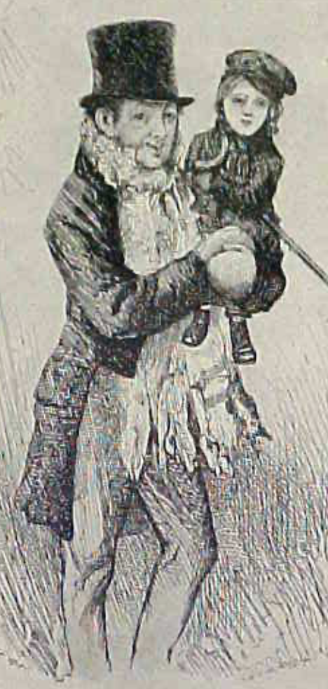
Review: The Watershed: 1870 as an Inflection Point
As of 1870, had the Industrial Revolution raised the standard of living or lightened the toil of the working class in England, the country at its center?
Yes
No
It’s not clear
Why? Malthusian forces—population explosion & thus smaller farm sizes. Growth, the growth had been slow 0.8%/year?

Slide 85
Globalization
Who called the era of globalization and growth from 1870 to 1914 an “economic El Dorado”?
Karl Marx
John Stuart Mill
Thomas Robert Malthus
John Maynard Keynes
None of the above
What would the others have said?

Slide 86
Migration
How many people of the roughly 1.5 billion then-population of the world left their continents of origin between 1870-1913?
10 million
50 million
100 million
200 million
400 million

Slide 87
Before 1870, Ideas Growth Not Fast Enough
And population growth accelerates as the world is not rich enough to undergo the demographic transition:
Value of useful and deployed ideas about technology and organization
-8000: 1
1: 3.5
1500: 4.75
1800: 9
1870: 16
2020: 421
Growth Rates:
-8000 to 1500: 0.02%/year
1500 to 1800: 0.2%/year
1800 to 1870: 0.8%/year
1870 to 2020: 2.3%/year
What caused these accelerations? What caused this last acceleration?

Slide 88
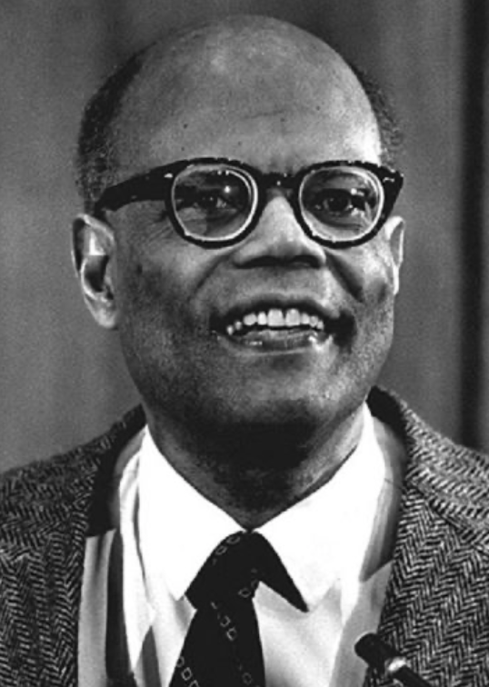
The Last Acceleration
The industrial research lab to routinize invention, and the modern corporation to routinize diffusion and deployment
Plus general purpose technologies—machine tools, non-human power sources
Arthur Lewis:
“New commodities: telephones, gramophones, typewriters, cameras, automobiles, and so on, a seemingly endless process whose latest twentieth-century additions include aeroplanes, radios, refrigerators, washing machines, television sets, and pleasure boats. Thus a rich man in 1870 did not possess anything that a rich man of 1770 had not possessed; he might have more or larger houses, more clothes, more pictures, more horses and carriages, or more furniture than say a school teacher possessed, but as likely as not his riches were displayed in the number of servants whom he employed rather than in his personal use of commodities…”
Not so much the particular technologies, as the grasping of the fact that there was a broad and deep range of new technologies to be discovered.
As much as it was new technologies, it was large-scale corporate organizations that could and did plan the division of labor to make use of and then market technologies.
And as much, it was that the global market meant that there was now a great deal of money to be made from the routinization of the exploration, development, and deployment of technological possibilities

Slide 89
Worldwide: The Broad Sweep
Post-1870 is the miracle:

Slide 90
“The West”
800, 1500, 1770, or 1870?:

Slide 91
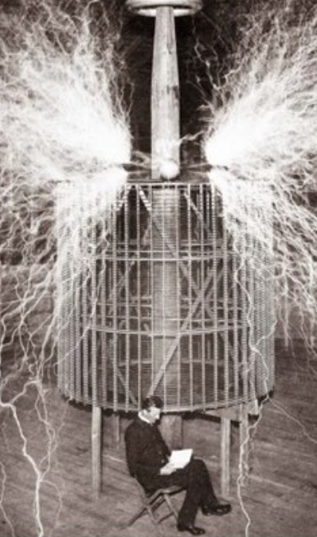
Who Is This Man?
And is he in any real danger?
Thomas Edison, and no
Andrew Carnegie, and no
Nicola Tesla, and no
Thomas Edison, and yes
Herbert Hoover, and yes

Slide 92
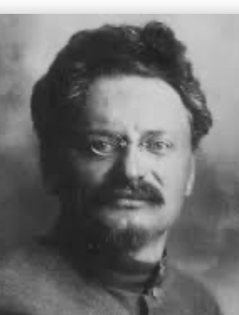
Lev Bronstein
Why did he say this?
“I had had no time to more than catch the general life-rhythm of the monster known as New York…”
“I left for Europe with the feeling of a man who has had only a peek into the furnace where the future is being forged…"

Slide 93
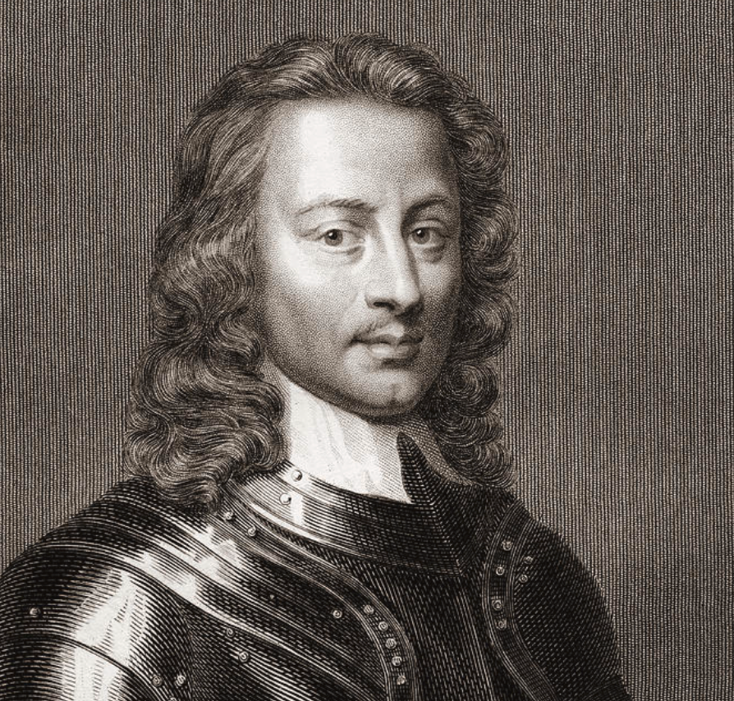
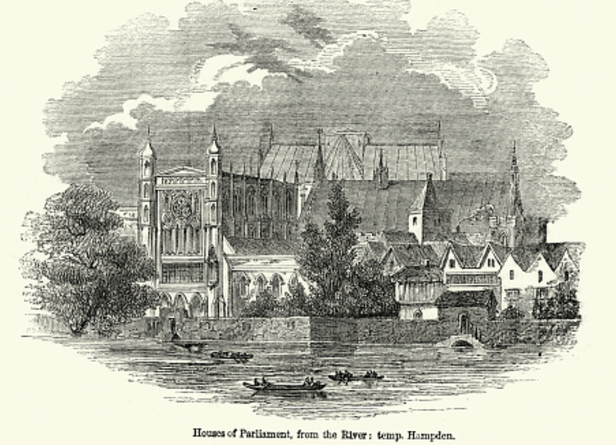
Review: Political Economy
From “Divine Right” and “Natural Order” to Enlightenment values…
Who was the first person to draft these words:?
“We hold these truths to be sacred & undeniable:
that all men are created equal & independant,
that from that equal creation they derive rights inherent & inalienable,
among which are the preservation of life, & liberty, & the pursuit of happiness;
that to secure these ends, governments are instituted among men, deriving their just powers from the consent of the governed…”
John Locke
Niccolo Machiavelli
Thomas Hobbes
Thomas Jefferson
George Washington
Why did he write them?

Slide 94
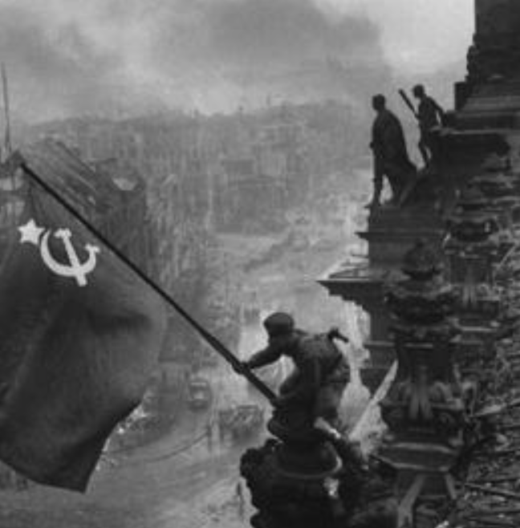
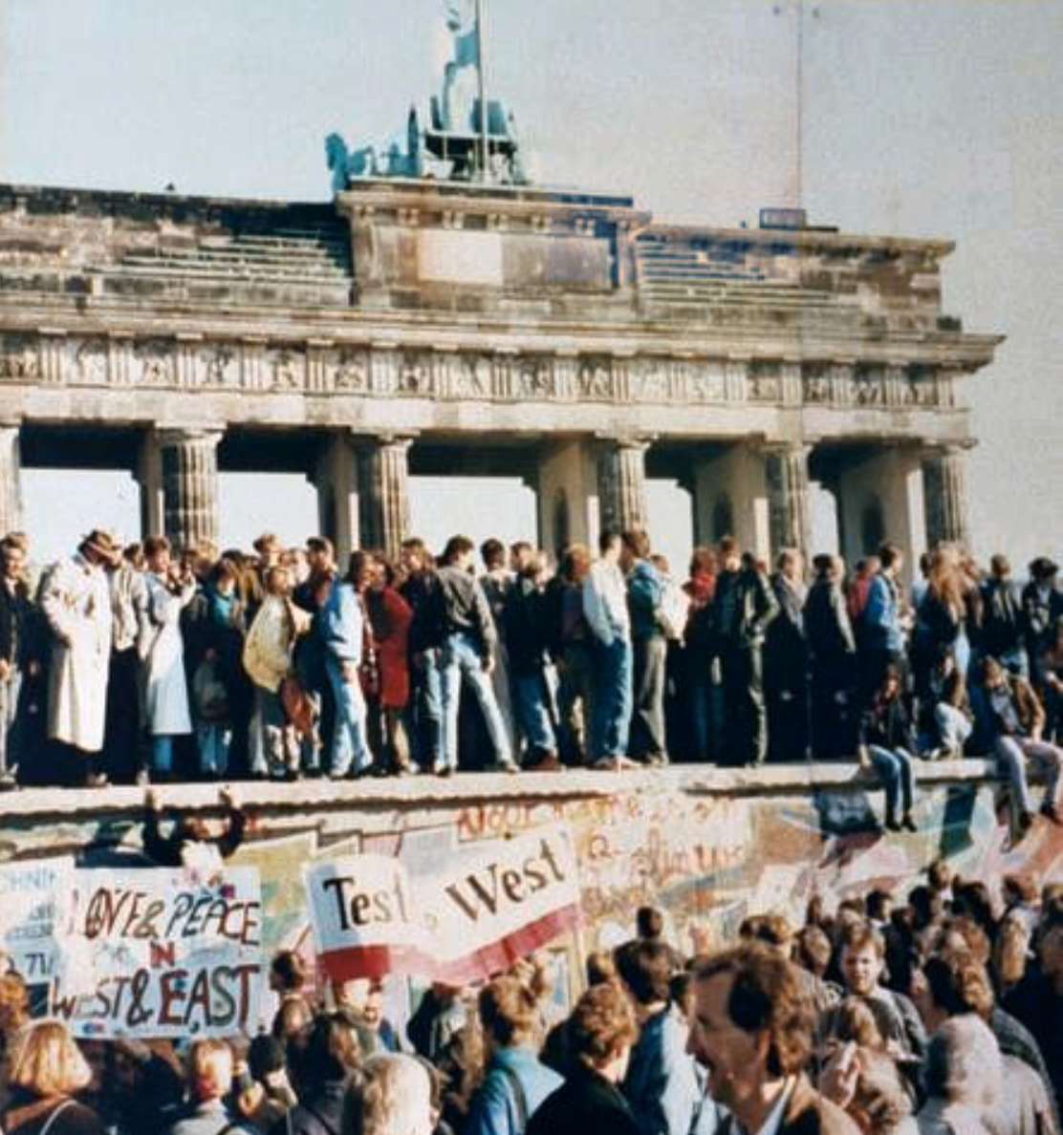
What Was the Proper Political Order?
Fears of “democracy” among American founders:
Madison: “Democracies have ever been spectacles of turbulence and contention... incompatible with personal security or the rights of property... as short in their lives as... violent in their deaths…”
Jefferson: “Gen’l Washington had not a firm confidence in the durability of our government… [& this] had some weight in his adoption of… ceremonies… calculated to prepare us gradually for a change which he believed possible…”
Hamilton: “the British government… best” as the only one “unit[ing] public strength with individual security…”
Adams: The American president should be announced as: “His Highness, the President of the United States, and Protector of the Rights of the Same…”
Question of political order thought settled: first in the rubble of Berlin in 1945, and then in the streets of East Germany in 1991:
Settled in favor of representative democracy, private property, & social insurance—late-1900s liberal democracy
But now reopened? Min Zhu (朱民) to me in 2015: “What are you Americans going to do to fix your broken political system?”

Slide 95
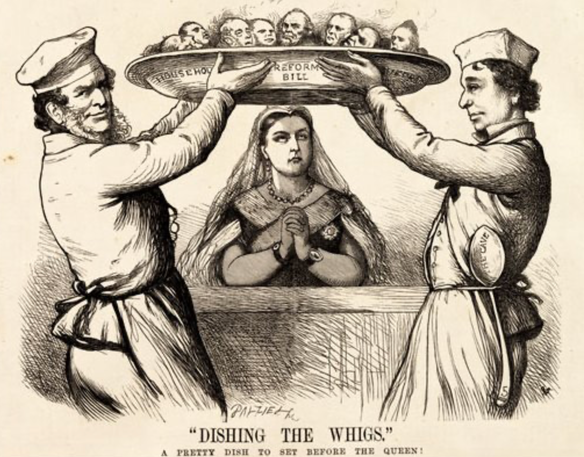
Franchise Restricted to the Rich Could Not Maintain Itself
The dynamic of franchise extension
Liberals in power would try extend on the principle that the new, poorer voters would be less conservative and would support them.
Threatening revolution would lead even conservatives to seek to extend the franchise in order to peel off of the revolutionary coalition those of the disenfranchised who had the most social power:
Earl Grey (yes, the tea): “The Principal… is to prevent… revolution…. I am reforming to preserve, not to overthrow…”
Charismatic leaders with popular followings would seek to give them votes, and then rule via plebiscites—going around the traditional elites
(Peculiar thing about Trump-Johnson: minority, and core is a minority of a minority…)
Conservatives: “dish the Whigs”—opportunities to form winning coalitions by appealing to those who were no profiting from the market economy, or felt that they were losing relative status in some ways…

Slide 96
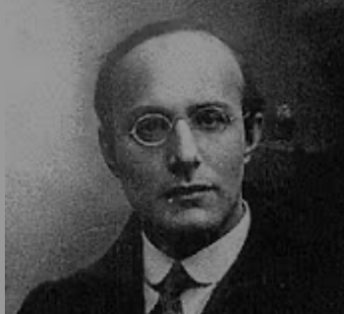
Popular Government and the Market Economy: Society’s Revenge
Karl Polanyi
People believe they have rights—to stable, supportive, nurturing communities; to incomes commensurate with their skills and status; and to money flows that will provide economic stability…
But a market society turns these things—land, labor, and finance—into commodities…
But they are not real commodities, they are fictitious commodities
And so you get your rights only if they satisfy a market profitability test
The only rights a market society respects are property rights:
& the only property rights that are worth anything are those that help you produce things for which rich people have a serious jones
Society will have its revenge: it will protect itself against the market logic, somehow, some way…

Slide 97
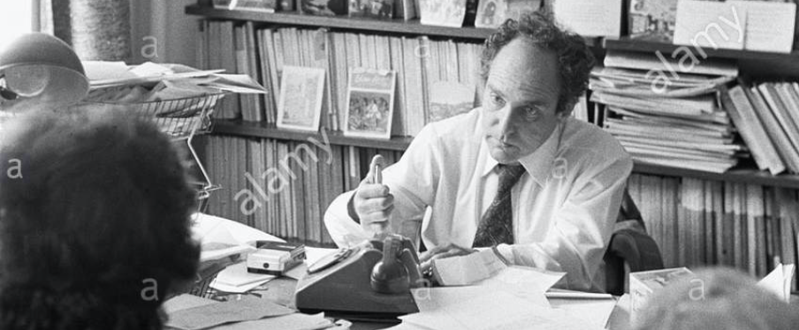


Digression: 5 Thinkers
Who shape my thought about the long 20th century—and how should, I think, shape yours
Beware! They are all deeply flawed…
But they are also geniuses, each in his way…
Beware of their followers! An iron law of ideology: a thinker’s most extravagant and aggressive followers will latch onto the stupidest and most shortsighted and wrong of their doctrines…
In historical order: Marx, Keynes, Hayek, Polanyi, Gellner
The other three thinkers:
Keynes: All that we need to produce general prosperity is technical adjustments to our system. Then the kingdom of freedom and prosperity will be within our grasp—and our major problems will no longer be economic ones
Gellner: The energy that most 19th century thinkers thought would go to “class“ went to “ethnos“ or “umma“ instead. The construction of ideological legitimations that makes sense both to dominants and to submissives who nevertheless believe they are part of some in-group is the key to understanding how societies stabilize themselves
Marx: Only the market economy will focus society’s energy on paying through the nose to boost the economy’s capital stock and to harvest the fruits of science and technology and then deploy them in production. But because the only demands in a market economy that matter are effective demands, the market economy also becomes a more “effective” means of slavery, for private property leads the proletariat to enslave themselves

Slide 98
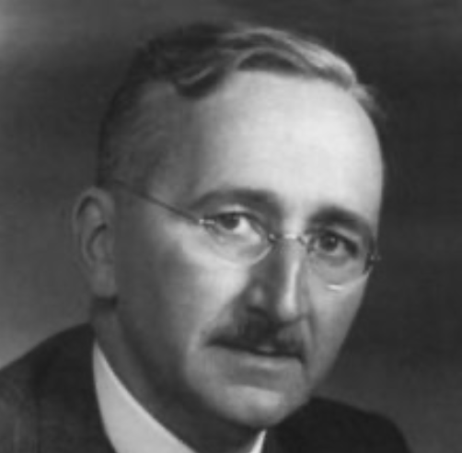
Hayek and Polanyi
Thumbnails on our first two:
Hayek:
Only the market economy can use society’s knowledge.
But the market economy cannot produce “social justice” and should not be asked to try—in fact, we need to recognize that all we can attain is freedom, and that will bring general prosperity, but that justice will be forever outside our reach
Polanyi:
The market economy turns land, labor, and finance into “fictitious commodities”
Society will have its revenge via a “double movement”

Slide 99
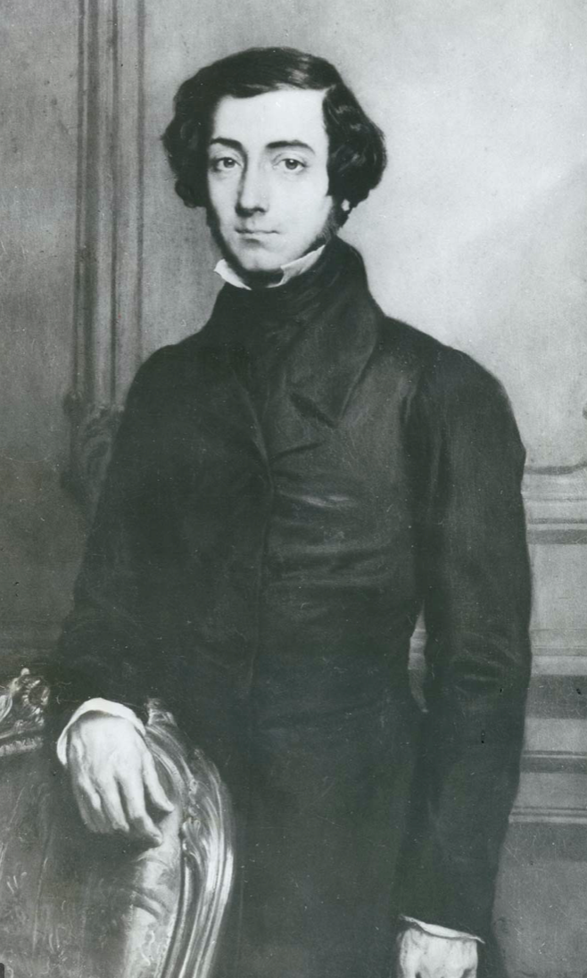
Plus Tocqueville
Toqueville on the rich as “elder brothers” in 1848:
“In the country all the landed proprietors, whatever their origin, antecedents, education or means, had come together, and seemed to form but one class: all former political hatred and rivalry of caste or fortune had disappeared from view. There was no more jealousy or pride displayed between the peasant and the squire, the nobleman and the commoner; instead, I found mutual confidence, reciprocal friendliness, and regard. Property had become, with all those who owned it, a sort of badge of fraternity. The wealthy were the elder, the less endowed the younger brothers; but all considered themselves members of one family, having the same interest in defending the common inheritance. As the French Revolution had infinitely increased the number of land-owners, the whole population seemed to belong to that vast family. I had never seen anything like it, nor had anyone in France within the memory of man…”
“The territorial aristocracy of past ages… [was] obliged… to come to the help of its servants and relieve their distress” no such reciprocal ties of obligation bound the aristocrats of manufactures to their workers: thus “the manufacturing aristocracy which we see rising before our eyes is one of the hardest that have appeared on the earth…”

Slide 100
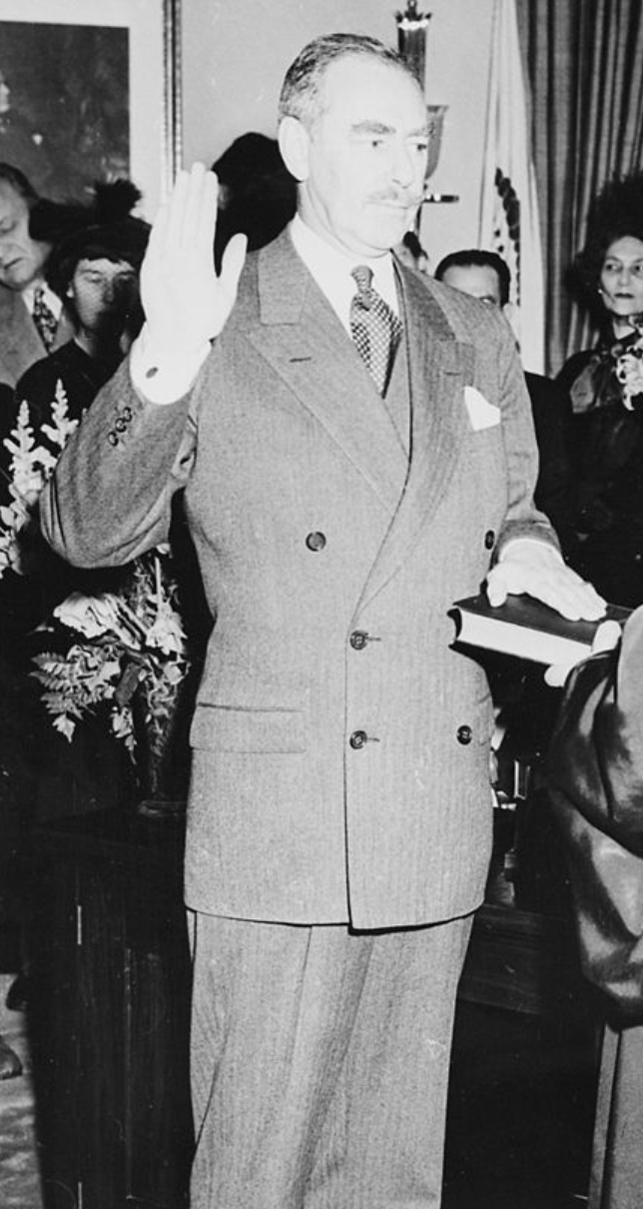
Plus Acheson
Dean Acheson, Secretary of State for Harry S Truman:
On the Republican Party as the party of wealth, enterprise, and opportunity:
“This business base of the Republican Party is stressed not in any spirit of criticism. The importance of business is an outstanding fact of American life. The achievements of business have been phenomenal. It is altogether appropriate that one of the major parties should represent its interests and its point of view…”
The subsequent transformation of the Republican Party from those who were going to become millionaires, or become even greater millionaires; to those who fear that they would lose it all…

Slide 101
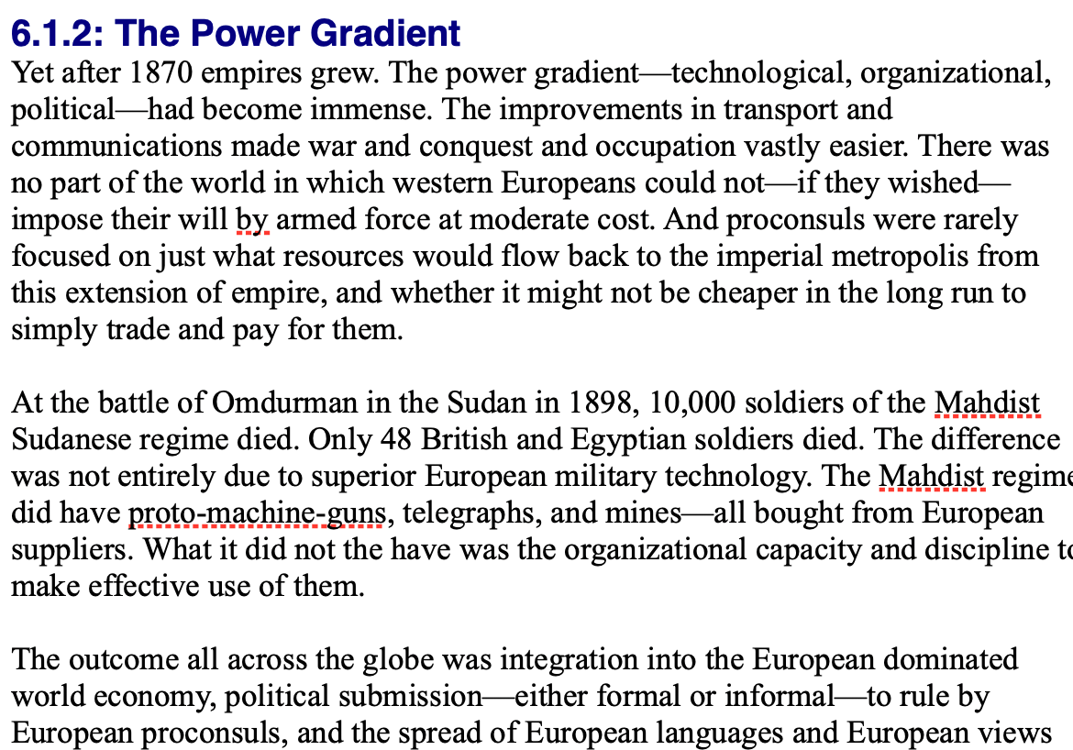
Review: Empire
By 1810 the tide of empire had been clearly ebbing…
But then things turned around: the power gradient:

Slide 102
To Your iClickers!
According to Eichengreen, graphing international capital flows and mobility since 1850 over time produces a graph that is:
V-shaped
U-shaped
W-shaped
An upward line
None of the above

Slide 103
To Your iClickers!
According to Eichengreen, the responsibilities of a pre-World War I central bank as steward of the global gold standard and also as lender-of-last-resort in domestic financial crises were:
in complete harmony
in irresolvable tension
for the most part manageable, before World War I at least, via fancy footwork and good luck
not understood
none of the above

Slide 104
To Your iClickers!
According to Eichengreen, the experience of being on the gold standard for North Atlantic economies in the 1870-1914 period was by and large a happy one, and the experience of countries at the world economy’s periphery was:
also by and large a happy one.
a mixed one.
a source of considerable tension, instability, and political upset.
once again, manageable with fancy footwork and a little good luck.
none of the above.

Slide 105
To Your iClickers!
In Eichengreen’s view, if World War I had somehow been avoided, would the global gold standard have remained stable in the 1920s and 1930s?
There are no guarantees, but probably yes.
There are no guarantees, but probably no.
Certainly not!
Certainly yes—unless several North Atlantic economies experienced a socialist revolution
None of the above.

Slide 106
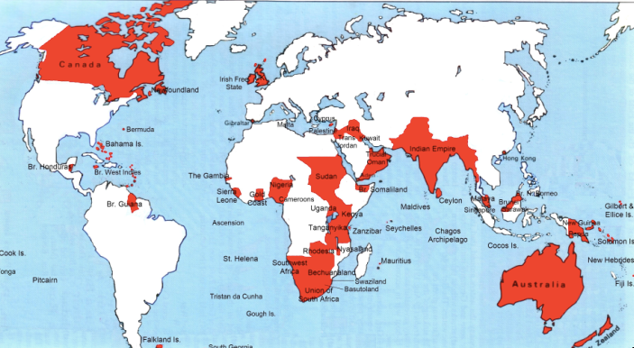
Empire

Slide 107
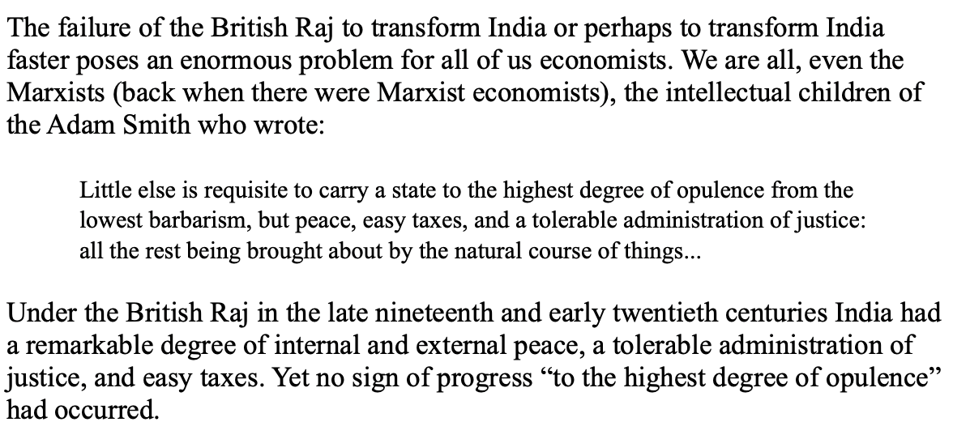
India
Why didn’t the British transform India into an industrial power?

Slide 108
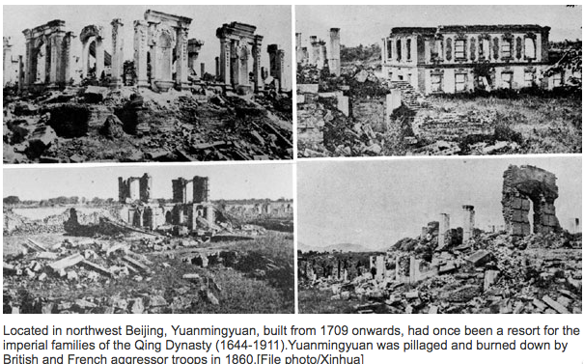
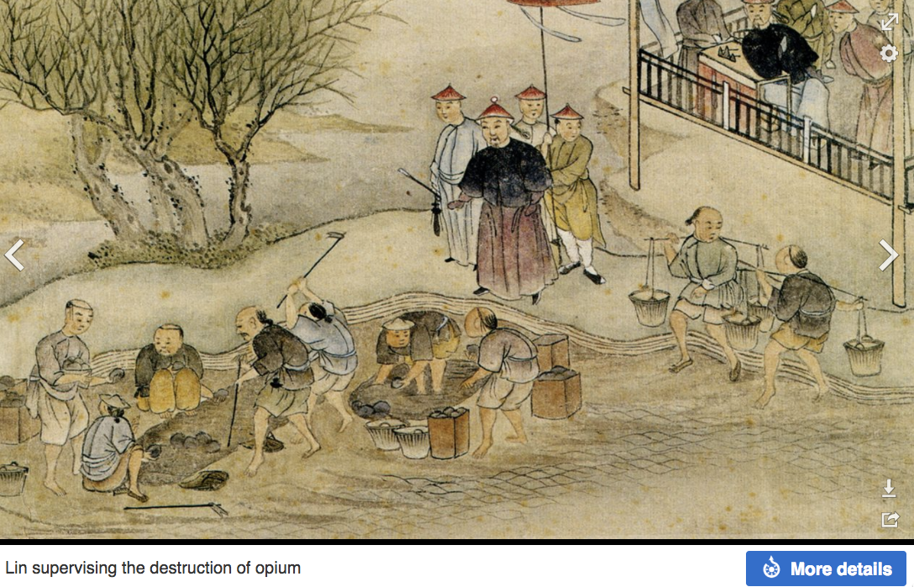
“Self-Strengthening”
The puzzle of China vs. Japan
Great Qing (大清)(1644-1912)
Wu Sangui (吳三桂)
The Rebellion of the Three Feudatories (三藩之亂)
Kangxi and Qianlong: “revere the emperor and expel the barbarians” is difficult to pursue when the emperor and his clan identify themselves as “barbarians”
Tai-Ping Rebellion (太平天國運動)
Cixi ( 慈禧太后)
Li Hongzhang (李鴻章)the Kai-Ping coal mine, Chang Yen-Mao, and Herbert Hoover

Slide 109
Formal Empires
There were, broadly, three views as to why European late-1800s empires rose to such domination, each of which with its own view of what was to be done to fix the situation:
One view is that of John Hobson: The major economic problem was the business cycle. Equipping the military needed to maintain the empire puts people to work. And an empire is a good source of consumers for the products of domestic factories. European governments that pursued empire, Hobson thought, were less likely to face economic distress and so more likely to continue in office.
A second view was that of Joseph Schumpeter: imperialism as the last gasp of military status aristocracy.
The third view was that empires were ordained by God—or at least morally required or desirable, for European powers had a civilizing mission. The Europeans were lucky enough to be the grownups, and it was the obligation of the grownups to civilize the world. But perhaps civilization is best spread by newspapers and books and merchants and engineers, rather than by alien proconsuls? Just a thought.

Slide 110
Informal Empires
But even where Britain (or France, or Germany, or Portugal, or Spain, or those who thought of themselves as descended from the conquistadores of Castile, or Anglo-Saxon settlers) did not rule, they reigned:
Britain seemed successful: playing by Britain’s rules seemed wise…
Britain was powerful: playing by Britain’s rules seemed likely to keep it from getting annoyed…
Britain was working very hard to make itself attractive—to make becoming a Briton-by-proxy of some sort straightforward and profitable in both money and cultural terms…
Britain was the first-mover hegemon: international cooperation was on its terms…

Slide 111
Catch Our Breath…
Comments?
Questions?

Slide 112
Review: Revolutions
“Petty Officer Lemmgen… arrived at the Ministry [of War]… found… Lieutenant HambuRger.... Lemmgen produced a typed document with the following text: ‘Comrades and Workers! The Ebert-Scheidemann government have made themselves impossible.... The undersigned Revolutionary Council has provisionally assumed power.’
“Lieutenant Hamburger inspected the document and became properly indignant. ‘But where are the signatures? Before I can comply with this order, you’ll have to go back and get it properly signed. Otherwise any little shorthand typist could declare the government deposed.’ Petty Officer Lemmgen... saw the logic…. So he and his men saluted... and made their way back to the Revolutionary Council to obtain the necessary signatures....
“But by the time he had obtained the signatures, Lemmgen had learned that the People’s Naval Division had declared itself neutral. So he did not return to the Ministry of War…”

Slide 113
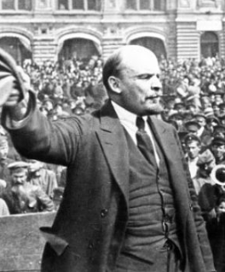
Lenin
A quick power grab…
Confidently expecting a German revolution, and then massive aid…
Brutal civil war
Kerenskyites
Reds
Whites
Nationalists
What was the revolutionary government to do?
Ludendorff’s German war economy…

Slide 114
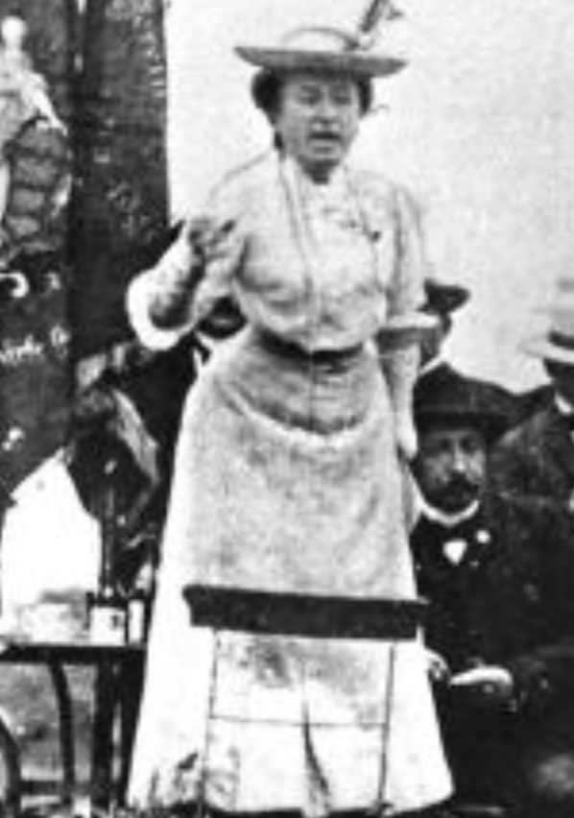
Red Rosa on Lenin
“Without general elections, without unrestricted freedom of press and assembly, without a free struggle of opinion, life dies out in every public institution…. Only the bureaucracy remains…. A few dozen party leaders of inexhaustible energy and boundless experience direct and rule….
“An elite of the working class is invited from time to time to meetings where they are to applaud the speeches of the leaders, and to approve proposed resolutions unanimously–at bottom, then, a clique affair…. Such conditions must inevitably cause a brutalization of public life: attempted assassinations, shooting of hostages, etc…
“Freedom only for the supporters of the government, only for the members of one party–however numerous they may be–is no freedom at all. Freedom is always and exclusively freedom for the one who thinks differently. Not because of any fanatical concept of “justice” but because all that is instructive, wholesome and purifying in political freedom depends on this essential characteristic, and its effectiveness vanishes when ‘freedom’ becomes a special privilege…

Slide 115
Digression: How to Study
Will I ask you about Jan Christian Smuts? About the prayer (and theology) of the Grigua?
No…
Themes and concepts…
But you need narratives and stories to hang onto them…
And our brains are very good at deep-sixing useless information
Andy Matuschak: Why Books Don’t Work <https://andymatuschak.org/books/>:
“Picture some serious non-fiction tomes. The Selfish Gene; Thinking, Fast and Slow; Guns, Germs, and Steel; etc.
“Have you ever had a book like this—one you’d read—come up in conversation, only to discover that you’d absorbed what amounts to a few sentences? I’ll be honest: it happens to me regularly. Often things go well at first. I’ll feel I can sketch the basic claims, paint the surface; but when someone asks a basic probing question, the edifice instantly collapses. Sometimes it’s a memory issue: I simply can’t recall the relevant details. But just as often, as I grasp about, I’ll realize I had never really understood the idea in question, though I’d certainly thought I understood when I read the book. Indeed, I’ll realize that I had barely noticed how little I’d absorbed until that very moment. I know I’m not alone here…

Slide 116
Skipped Topic: Pre-1914 Political Economy: Over in Europe
The June Days of 1848 in Paris:
Tocqueville:
“The insurrection of June [1848]... class against class... a blind and rude, but powerful, effort on the part of the workmen to escape from the necessities of their condition, which had been depicted to them as one of unlawful oppression…. The closing of the national workshops… occasioned the rising…”
“Thousands… hastening to our aid from every part of France.... Thanks to the railroads, some had already come from fifty leagues’ distance... every class of society... peasants... shopkeepers... landlords and nobles all mingled together... they rushed into Paris with unequalled ardour: a spectacle as strange and unprecedented in our revolutionary annals.... The insurgents received no reinforcements, whereas we had all France for reserves…”

Slide 117
French Politics
Régimes stability is not on the menu:
the terrorist dictatorship of the Jacobins (the mainspring of popular government… amid revolution it is at once virtue and terror: virtue, without which terror is fatal; terror, without which virtue is impotent…)
a corrupt and gerrymandered 5-man executive of the Directory, defended on October 5, 1795 by the “whiff of grapeshot” of Napoleon Bonaparte and Joachim Murat, that managed to generate the first modern hyperinflation, defended itself against a royalist coup plotted by two of its five members (Barthelemy and Carnot) and its most successful general (Pichegru), and was then overthrown by the same Napoleon in 1799.
a dictatorship, with Napoleon Bonaparte as “First Consul”, until 1804.
an empire, with Napoleon Bonaparte as Emperor of the French, until suppressed by the other European powers in 1815.
a restored Bourbon monarchy, with first Louis XVIII and then Charles X, until 1830.
an alternative Orleanist monarchy, with King Louis-Philippes as the king-citizen, overthrown in 1848.
a second republic, overthrown by its own president, Napoleon’s nephew Louis Napoleon, which collapsed under pressure of military defeat in 1870.
a socialist commune, in Paris at least.
a third republic, which suppressed the commune—but promptly chose a royalist Marshal MacMahon, as president.
a failed attempt by third republic president Marshal MacMahon to replace himself by a King Henry V.
a failed attempt by the ex-Minister of War Georges Boulanger to seize power for his RRR movement: Revanche, Révision, Restauration (revenge on Germany, revision of the constitution, restoration of the monarchy).

Slide 118
Left-Wing Normal European Politics I
Disjunction between policies and rhetoric:
The Socialist Party of Germany’s Erfurt and Gotha programs seek things like: holidays for elections, two-year legislative terms, the right to bear arms, equal rights for women, the prohibition of spending public funds for religious purposes, free public schools and colleges, free medical care including midwifery, an eight-hour working day, no child labor under 14, a 36-hour minimum weekend, an occupational safety and health administration…

Slide 119
Left-Wing Normal European Politics II
Disjunction between policies and rhetoric:
But also: “By every lawful means to bring about a free state and a socialistic society, to effect the destruction of the iron law of wages by doing away with the system of wage labor.” And they sought: “the transformation of the capitalist private ownership of the means of production—land and soil, pits and mines, raw materials, tools, machines, means of transportation—into social property and the transformation of the production of goods into socialist production carried on by and for society.” And they believed: “This… emancipation… of the entire human race…. But it can only be the work of the working class, because all other classes… have as their common goal the preservation of the foundations of contemporary society.”

Slide 120
Center and Right-Wing Normal European Politics
The touchstone was “fairness”: it was not fair that those who did not work hard and did not play by the rules got lots of good things:
Those who did not play by the rules could be on either end of the wealth-and-power spectrum:
Parasitic aristocrats and cruel plutocrats
Those poor who wanted something for nothing, or got above their station
A middle-class, social order movement
Focus voters’ attention on the disruptive utopian aspirations of the left, and electoral coalitions could be preserved…
Preserve as much as possible of old orders of hierarchy in changing times:
Reform to preserve; change so things could stay the same
Find new reasons why hierarchy is good: social darwinism

Slide 121
Magnifying Non-Economic Cleavages Had Dangers
Society under threat not by economic inequality but by social disorder—or aliens—or other nations. Plus:
A right-wing landed and bureaucratic upper class that had, by and large, lost its social role.
A belief by politicians anxious to paper over class divisions that they could be papered over with national or ethnic unity.
A growing social-darwinist current that struggle was good, and the victors should be rewarded
Even or especially military struggle by peoples-in-arms, over not what language a province would be administered in but who would live there
These stored up trouble as 1914 approached.
In 1919 John Maynard Keynes was to write, bitterly, that he, his peers, and his elders had regarded:
“the projects and politics of militarism and imperialism, of racial and cultural rivalries, of monopolies, restrictions, and exclusion, which were to play the serpent to this paradise… [as] little more than the amusements of his daily newspaper…”

Slide 122
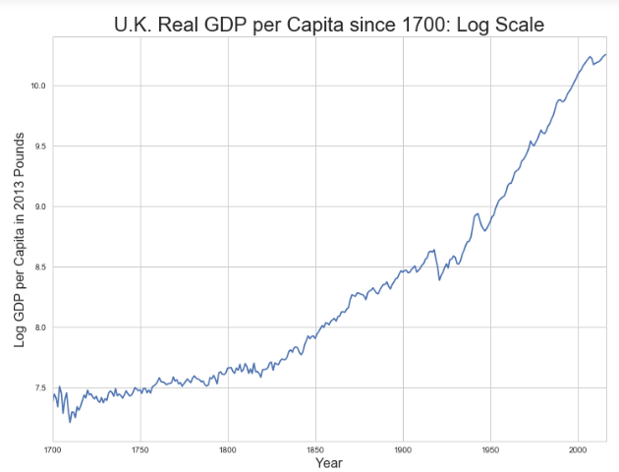
Skipped Topic: Passing the Baton: From Britain to America
The Industrial Revolution took place in Britain
The standard explanation four or five largely independent strands coming together.:
Limited government, security of property, and freedom of contract
Science and the technological tradition of sustained inquiry
Victory in the wars of the Commercial Revolution era
Machinery making, "tinkering", and "gadgets"—primarily made out of metal.
Coal in Britain—the only thing that made a steam engine potentially profitable.
Plus high elasticity of demand for leading-sector products…
http://bradford-delong.com brad.delong@gmail.com

Slide 123
iClickers: Why Breaktrhrough?
The principal reason that the Industrial Revolution took place in late eighteenth century Britain (rather than in Sung China, or Abbasid Baghdad, or Antonine Dynasty Rome, or during the Hellenistic Age) is:
A lack of human numbers thinking about problems of production
A lack of good means of communication—e.g. printing—for diffusing information about how to solve problems of production
A lack of experience using coal as an energy source
A lack of the incentive created by high real wages leading to a strong desire to make labor more productive
None of the above/not enough information
http://bradford-delong.com brad.delong@gmail.com

Slide 124
iClicker: Why Passing the Baton
The principal reason that the twentieth century was an American rather than a second British century was:
The United States’s aggressive and enthusiastic welcome of immigrants
The United States’s focus on broad-based technical education
The United States’s extraordinary abundance of natural resources driving high real wages and enormous incentives to build machines to manipulate matter
A U.S. government that took industrial development as a key policy goal, rather than being comfortable with laissez-faire
None of the above/not enough information
http://bradford-delong.com brad.delong@gmail.com

Slide 125

British Productivity Growth Acceleration
http://bradford-delong.com brad.delong@gmail.com

Slide 126

But Even in the First Half of the Nineteenth Century the U.S. Was Outpacing Britain in Growth…
Even in the first half of the nineteenth century—the period in which the British Industrial Revolution made it the wonder of the world—economic growth in the United States was proceeding faster than in Britain.
While British real GDP per capita was increasing at less than 0.6 percent per year
American was growing at a hair over one percent per year.
And a significantly larger share of GDP was going to the white working class in the United States, in the north at least:
The extraordinary abundance of land and the possibility of "lighting out for the territory", in the words of American author Mark Twain, gave even workers without property or notably scarce skills substantial economic bargaining power.
http://bradford-delong.com brad.delong@gmail.com

Slide 127
And Starting in the Late Nineteenth Century
Second Industrial Revolution…
Why the U.S. and Germany, and not Britain?
Immigration and Population
Was resource scarcity no longer a factor?
Was the differential in the growth rate h of the stock of useful economic knowledge even greater than the differential in the growth rate g of the efficiency-of-labor?
http://bradford-delong.com brad.delong@gmail.com

Slide 128
Phases of American Growth
1.0% per year in GDP per capita from 1760-1860: resource abundance
1.6% per year in GDP per capita from 1860-1929:
“Great traverse”: K/Y ratio up from 2.5 to 4
Half of it an increase in savings rates
Half of it a fall in the price of capital goods
2.5% per year in GDP per capita from 1929-1973
“Fordism”
Expected further acceleration: it did not happen
Post-1973
Productivity slowdown 1973-1995 (environment, oil, baby boom, feminism)
“New economy” 1995-2006
Post-2006 collapse of growth
http://bradford-delong.com brad.delong@gmail.com

Slide 129

American Productivity Growth Acceleration
http://bradford-delong.com brad.delong@gmail.com

Slide 130

Early Nineteenth Century: Westward Expansion
Westward expansion
The “American System”
Abundant natural resources
Very high real wages
Focus on raising labor productivity
Hence fast efficiency-of-labor growth
Britain, by contrast, focused on economizing on (non-coal) raw materials
http://bradford-delong.com brad.delong@gmail.com

Slide 131
The Importance of Resources 1760-1860
Major westward expansion and "Amerindian removal”
The century 1760 to 1860 before the Civil War.
We have U.S. output-per-worker growth then at about 1.0% per year…
…in contrast to British output-per-worker growth at about 0.5% per year.
We have the U.S. population and labor force growing at 2.5% per year…
…from 2.5 to 30 million.
http://bradford-delong.com brad.delong@gmail.com

Slide 132


The Importance of Resources 1760-1860
Recall our basic Solow Model:
http://bradford-delong.com brad.delong@gmail.com

Slide 133

The Importance of Resources 1760-1860
Recall our basic Solow Model:
Assume K/Y constant, so the growth rate g of the efficiency of labor and the growth rate of output-per-worker are the same:
http://bradford-delong.com brad.delong@gmail.com

Slide 134
The Importance of Resources 1760-1860
Recall our basic Solow Model:
Assume K/Y constant, so the growth rate g of the efficiency of labor and the growth rate of output-per-worker are the same:
http://bradford-delong.com brad.delong@gmail.com

Slide 135
The Importance of Resources 1760-1860
Recall our basic Solow Model:
Assume K/Y constant, so the growth rate g of the efficiency of labor and the growth rate of output-per-worker are the same:
Let’s, last, fit this to history in the century before the 1860 election of President Abraham Lincoln and the ensuing American Civil War:
http://bradford-delong.com brad.delong@gmail.com

Slide 136

The Importance of Resources 1760-1860
Recall our basic Solow Model:
Assume K/Y constant, so the growth rate g of the efficiency of labor and the growth rate of output-per-worker are the same:
Let’s, last, fit this to history in the century before the 1860 election of President Abraham Lincoln and the ensuing American Civil War:
http://bradford-delong.com brad.delong@gmail.com

Slide 137

Westward Expansion
http://bradford-delong.com brad.delong@gmail.com

Slide 138

The Importance of Resources 1760-1860
We have two parameters left: γ and h, the weight of ideas in efficiency-of-labor growth and the rate of growth of the stock of useful ideas for the economy in American heads, respectively:
http://bradford-delong.com brad.delong@gmail.com

Slide 139

The Importance of Resources 1760-1860
We have two parameters left: γ and h, the weight of ideas in efficiency-of-labor growth and the rate of growth of the stock of useful ideas for the economy in American heads, respectively:
http://bradford-delong.com brad.delong@gmail.com

Slide 140
The Importance of Resources 1760-1860
Thus if γ→∞ then h→0.010
http://bradford-delong.com brad.delong@gmail.com

Slide 141
The Importance of Resources 1760-1860
Thus if γ→∞ then h=0.010
Thus if γ=3.0 then h=0.00667
http://bradford-delong.com brad.delong@gmail.com

Slide 142
The Importance of Resources 1760-1860
Thus if γ→∞ then h=0.010
Thus if γ=3.0 then h=0.00667
Thus if γ=1.0 then h=0.00
http://bradford-delong.com brad.delong@gmail.com

Slide 143
The Importance of Resources 1760-1860
Thus if γ→∞ then h=0.010
Thus if γ=3.0 then h=0.00667
Thus if γ=1.0 then h=0.00
Looking across the Atlantic Ocean to Great Britain, we see that over there it is indeed the case that h=0.005 from 1760 to 1860. Faster growth of h in America due to some catchup with the world's first and leading industrial nation seems likely. So γ=3.0 has some claim to be the most likely value…
http://bradford-delong.com brad.delong@gmail.com

Slide 144
A Counterfactual
The Royal Proclamation of October 1763:
Our Royal Will and Pleasure… no... Governor or Commander in Chief in... our... Colonies or Plantations in America do... grant Warrants of Survey, or pass Patents for any Lands beyond the Heads or Sources of any of the Rivers which fall into the Atlantic Ocean from the West and North West, or upon any Lands whatever, which, not having been ceded to or purchased by Us as aforesaid, are reserved to the said Indians, or any of them...
http://bradford-delong.com brad.delong@gmail.com

Slide 145

What If This Royal Proclamation Had Stuck?
What if ρ=0?
If γ → ∞ and h=0.010 then g=0.01
If γ=3.0 and h=0.00667 then g=−0.00125
If γ=1.5 and h=0.000 then g=−0.01
http://bradford-delong.com brad.delong@gmail.com

Slide 146
What If This Royal Proclamation Had Stuck?
What if ρ=0?
If γ → ∞ and h=0.010 then g=0.01
If γ=3.0 and h=0.00667 then g=−0.00125
If γ=1.5 and h=0.000 then g=−0.01
An America penned behind the Appalachians would probably have seen its living standards and productivity levels not growing at 1% per year from 1760 to 1860 but shrinking.
For γ=3.0, living standards and productivity levels would have shrunk at a pace of -0.125% per year
http://bradford-delong.com brad.delong@gmail.com

Slide 147
What If This Royal Proclamation Had Stuck?
What if ρ=0?
Of course, a poorer America would probably have seen fewer immigrants.
But it might not have seen that many fewer immigrants.
It would no longer have been quite as attractive to move from Britain to America over 1760 to 1860.
But it still would have been very attractive to move from France, Germany, Scotland—or most of all from Potato Blight-ridden Ireland...
In what other ways might this counterfactual alternate-history "little America" would likely have been different in 1860 than America actually was?
http://bradford-delong.com brad.delong@gmail.com

Slide 148

“Trail of Tears’
http://bradford-delong.com brad.delong@gmail.com

Slide 149
A large chunk of America's pre-1860 visible growing prosperity was based not just on African-American slavery, but also on "Amerindian removal"
http://bradford-delong.com brad.delong@gmail.com

Slide 150
Catch Our Breath…
Ask me two questions…
Make two comments…

Slide 151

Late Nineteenth-Early Twentieth Century: “Great Traverse”
Invention of the industrial research lab
First globalization
Technologies of Second Industrial Revolution
Economies of scale and mass production
Falling price of capital goods
Greater savings effort
Plus mass immigration
Rapidly rising inequality
Or was it? Emancipation…
http://bradford-delong.com brad.delong@gmail.com

Slide 152
Capital Deepening
Lowered deprecation rate δ
From 5% to 3% per year
http://bradford-delong.com brad.delong@gmail.com

Slide 153
Capital Deepening
Lowered deprecation rate δ
From 5% to 3% per year
Increased savings rate s
Capital-output ratio goes from 2.5 to 4 across 70 years
http://bradford-delong.com brad.delong@gmail.com

Slide 154
Capital Deepening
Lowered deprecation rate δ
From 5% to 3% per year
Increased savings rate s
Capital-output ratio goes from 2.5 to 4 across 70 years
with an α=1, output-per-worker proportional to the capital-output ratio
ln(4/2.5)/70 = 0.007
g = 0.9%/year
http://bradford-delong.com brad.delong@gmail.com

Slide 155
Capital Deepening
Capital-output ratio goes from 2.5 to 4 across 70 years
with an α=1, output-per-worker proportional to the capital-output ratio
ln(4/2.5)/70 = 0.007
g = 0.9%/year
Second Industrial Revolution
Large managerial corporation
Large-scale investment banking
Industrial research lab
Continent-wide market
Globalization
http://bradford-delong.com brad.delong@gmail.com

Slide 156

Mid Twentieth Century: Drive to High Mass Consumption
DARPA, etc.: two heads are better than one
“Fordist” oligopolies
Second globalization
Keynesian stabilization policies
Falling and then low inequality
For white guys…
http://bradford-delong.com brad.delong@gmail.com

Slide 157
Mid Twentieth Century: Drive to High Mass Consumption
DARPA, etc.: two heads are better than one
“Fordist” oligopolies
Second globalization
Keynesian stabilization policies
Falling and then low inequality
For white guys…
http://bradford-delong.com brad.delong@gmail.com

Slide 158
Catch Our Breath…
Ask me two questions…
Make two comments…

Slide 159
To Your iClickers
Which is the best statement of “Say’s Law”?
Mass unemployment is always the fault of the government preventing market prices from moving to equilibrium values, or hobbling enterprise via excess taxation or regulation.
There cannot be a “general glut”—if there is an excess supply of some currently-produced commodities, there will be an excess demand for others, and that will trigger a healthy market adjustment.
Supply creates its own demand: everything produced will be sold unless the government messes things up.
None of the above are good statements

Slide 160
To Your iClickers
Given that Jean-Baptiste Say abandoned Say’s Law in 1830, does anybody today believe in “Say’s Law”?
No.
Yes! John Cochrane of the Hoover Institution, for one: “Every dollar of increased government spending must correspond to one less dollar of private spending. Jobs created by stimulus spending are offset by jobs lost from the decline in private spending. We can build roads instead of factories, but fiscal stimulus can’t help us to build more of both. This is just accounting, and does not need a complex argument about ‘crowding out’…"

Slide 161
To Your iClickers
In the abortive German communist revolution of January 1919, Petty Officer Lemmgen and his forces failed to take control of the offices of the Ministry of War because:
Lieutenant Hamburger objected that the document authorizing him to do so was handwritten, and Lemmgen returned to Revolutionary HQW to get the document typed.
Lieutenant Hamburger objected that the document authorizing him to do so was not signed, and Lemmgen returned to Revolutionary HQW to get the document signed.
Lieutenant Hamburger objected that the Revolutionary Council that had produced the document was a bunch of traitors.
Lieutenant Hamburger objected that the Revolutionary Council was only made up of a minority of the leaders of the German Socialist Party.
None of the above.

Slide 162

Review: To Your iClickers
John Maynard Keynes thought that the prosperity of the pre-WWI years was:
Natural and stable: a logical development out of human drives that went from strength to strength, and could only be overthrown by a very unlikely disaster.
Artificial and unstable, and based on a very complicated system in which, largely by chance, a lot happened to go right.
Natural but unstable, in that it was a logical development out of humanity’s trading nature but could be disturbed by other human drives—like tribalism, and the lust for domination.
Artificial but stable, as constructed by the greatest minds of the age, and only overthrown by a very unlikely disaster.
None of the above

Slide 163
Review: Why the “Perfect Storm” of 1929-1933?
Previous Cycles:
1873—railroad
1884—railroad redux
1893—free silver
1904—Northern Securities
1907—gold drain to Britain
1914—disruption of the start of WWI
1920—deflation; return to “normalcy”
What brought previous downturns to a halt?
What made the Great Depression so great?

Slide 164
General Glut
How is it that there can be a "general glut" in which pretty much every produced commodity and the labor of workers are in excess supply, given that humans are far from satiated with production goods and given that one person's expenditure is another person's income?
Remember: you can take your income and use it either to buy things that are useful or to build up your stock of cash money. If there is excess demand for useful commodities, people can switch from producing whatever they were making to producing whatever is in short supply.
But the only way to build up your stock of cash is to try to cut your spending below your income. And since one person's spending is another person's income, that simply cannot be done in general.
If people in general try, the result is that spending and incomes fall economywide until they are both at such a low level that people de-prioritize building up their cash holdings.

Slide 165
Interwar Gold Standard
The interwar gold standard caused, deepened, and definitely did nothing toward curing or ameliorating the Great Depression…
There is nothing worse than attempting to credibly commit to an incredible policy
The fear that the gold standard would break down caused people to want to hoard cash—to build up their cash holdings.
The fear that the gold standard would break down caused governments to be extremely unwilling to boost their economies' cash supplies—such boosts might, governments feared, undermine confidence that their country would stay on the gold standard.
Big depressions happen when the popular demand for cash outstrips the government's supply
The interwar gold standard was thus a powerful motivator and stage-setter pushing both people and governments into the patterns of behavior that produced the Great Depression

Slide 166

“Crying ‘Fire! Fire!’ in Noah’s Flood…”
France gold acquisition policy
American gold acquisition policy
The weakness of the gold-exchange standard—that people knew the gold standard could and would be abandoned
Labor-side pressure…
Nothing worse than an attempt to credibly commit to an incredible policy…
And then the belief that inflation was always just around the corner…

Slide 167
The Presumption Before the Great Depression
The presumption before the Great Depression that the government was not responsible for managing and curing the business cycle…
Two strands reinforced each other.
The first was the strength of the idea of laissez-faire: that government (protecting property and enforcing contracts aside) was overwhelmingly a problem and not a solution. As John Maynard Keynes wrote in his essay The End of Laissez-Faire, a powerful drive behind that was: “the corruption and incompetence of eighteenth-century government…. Almost everything which the State did in the eighteenth century in excess of its minimum functions was, or seemed, injurious or unsuccessful. [And] on the other hand, material progress between 1750 and 1850 came from individual initiative…”
The second was social Darwinism—that, in the words of steelmaster Andrew Carnegie, the second-richest man in America circa 1905 and a man who gave away his entire fortune: “The price we pay for [our civilization]... is, no doubt, great.... The employer of thousands is forced into the strictest economies... [in] the rates paid to labor.... The law of competition... is here; we cannot evade it; no substitutes for it have been found; and while the law may be sometimes hard for the individual, it is best for the race, because it insures the survival of the fittest in every department..."
The result was a dominant belief—at least among the rich and powerful—that:
The market giveth, the market taketh away: blessed be the name of the market.

Slide 168
The Hoover Administration’s Reaction to the Great Depression
The 1929-1933 Hoover administration believed that little could be done.
That the only good things that could be done were to (a) repeatedly state that "prosperity is just around the corner" and (b) try to cut federal government spending and raise taxes in order to restore confidence and scotch the fear of high inflation.
As economist R.G. Hawtrey wrote, to worry about inflation in the midst of the Great Depression was like "crying 'FIRE! FIRE!' in Noah's Flood..."
Herbert Hoover himself wrote afterwards about how his administration had been dominated by the "'leave-it-alone liquidationists' headed by Secretary of the Treasury Mellon, [who] felt that government must keep its hands off and let the slump liquidate itself. Mr. Mellon had only one formula:
'Liquidate labor, liquidate stocks, liquidate the farmers, liquidate real estate'. He held that even panic was not altogether a bad thing. He said: 'It will purge the rottenness out of the system. High costs of living and high living will come down. People will work harder, live a more moral life. Values will be adjusted, and enterprising people will pick up the wrecks from less competent people'…"
Hoover went on to state that he did not share this view…
That raises lots of questions about how his administration worked…

